Slide 1
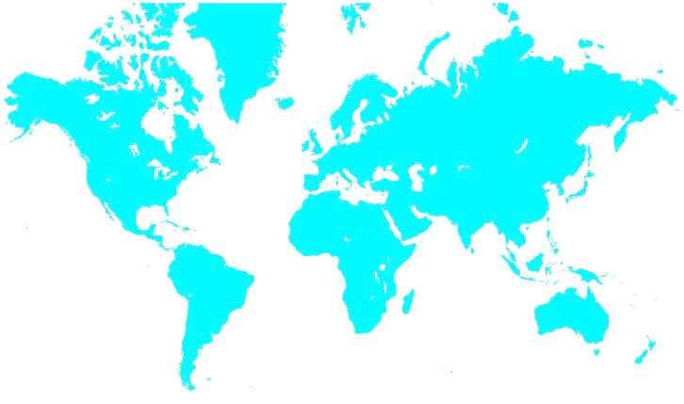

Cornerstone International Group
Regional Meeting - EMEA
Welcome to
Bucharest
November 6-8, 2014

Slide 2
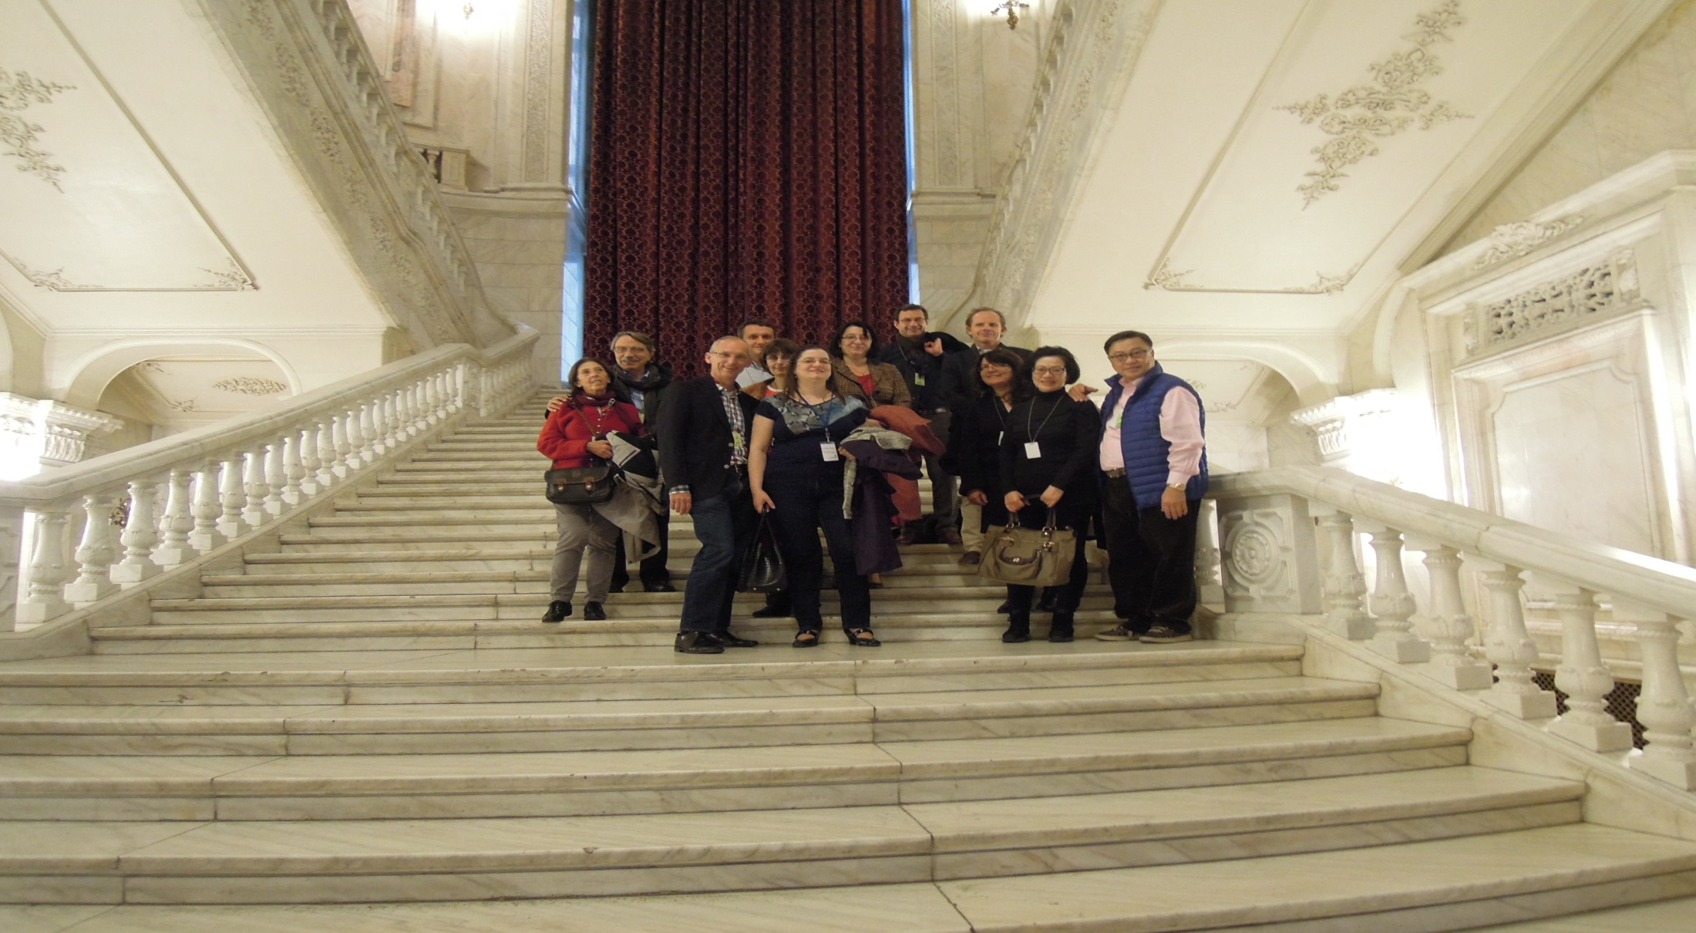
Thank You Cristina & Her Team

Slide 3
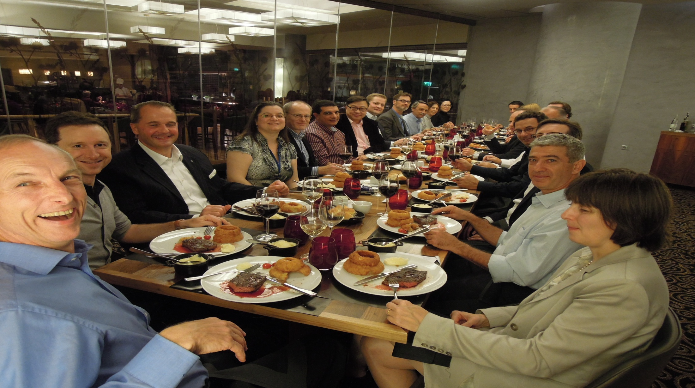
Thank You Alan for Leading
EMEA

Slide 4
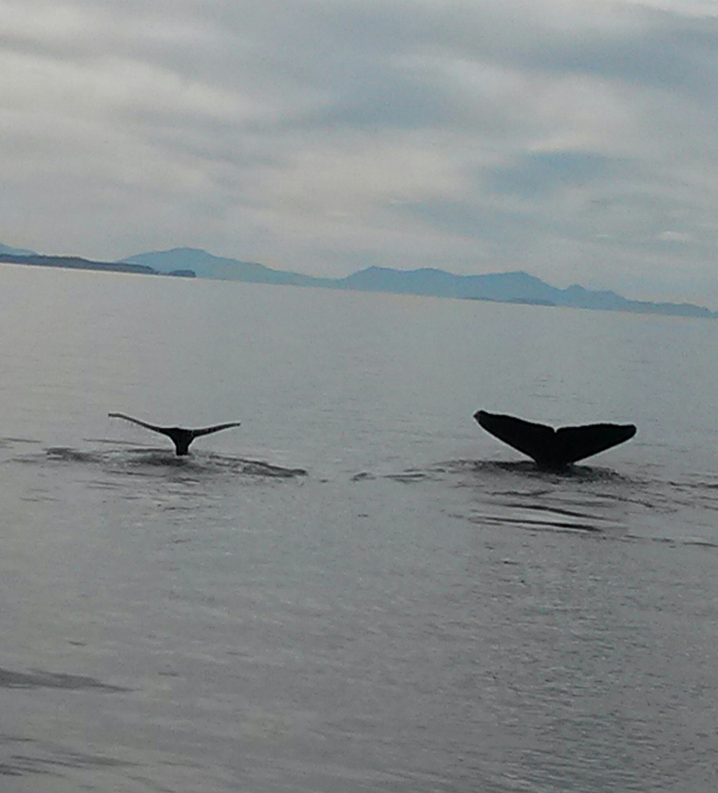
Whale Watching, August 2014

Slide 5
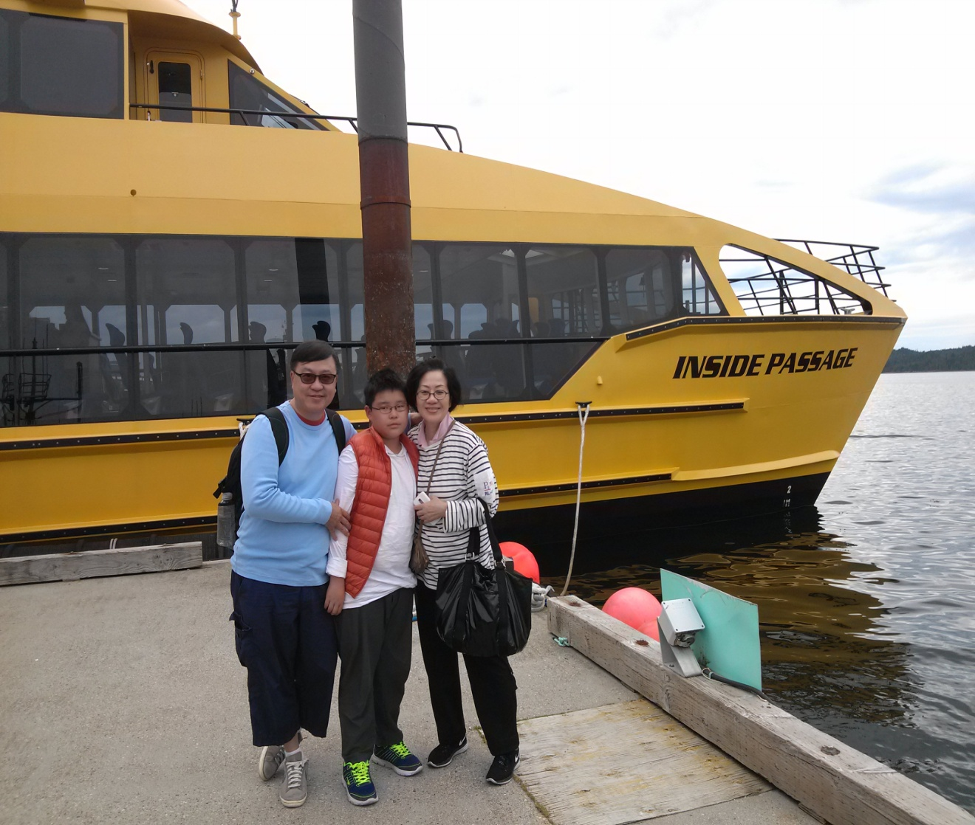
Simon , Camilla and Daniel
Simon , Camilla & Daniel

Slide 6
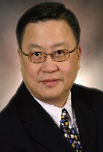
Profile: Simon Wan
Certified NLP Coach, Certified New Horizons Coach
Member of International Coach Federation
MBA & BSC, University of Alberta, Canada
In Shanghai, was CEO of British Inchcape Group, Central China & GM of Royal Philips Lighting, East Asia
President of China Team Executive Search & Chief Executive of Cornerstone International Group, China (since 2003) and Worldwide (since 2012)
In Canada, was China Trade Director of the Canadian Government of Alberta
In Hong Kong, was GM of Carnation Foods (Acquired by Nestlé) & GM of Marmon Group – Getz Brothers’ consumer division.

Slide 7

The Road to Win - CORE

Slide 8
What Cornerstone Value
- CCC
Community - Active Board that meets every 6 weeks. Regional catch ups once every 2 months. Functional Group meetings (Executive Coaching, M & A, future practice groups). Compulsory attendance of annual global meeting.
Credibility - Owner Operated, local strength. AESC for search & ICF Credentials for coaching. Marketing to go after global accounts/ approaches. Global website will have additional languages other than English in 2015
c) Continuity - ...Identify, select new members as well partner with existing members to be the best we can be individually, and as a global network.

Slide 9














2015 Global Board
Chairman & CEO
Simon Wan (Shanghai)
simon-wan@cornerstone-group.com
President
Larry Shoemaker (Atlanta)
larry-shoemaker@cornerstone-group.com
Chair of Member Development
America & Africa,
Ian Day (London)
Chair of Member Development
EuroME & Asia,
Alan Kneale (Liverpool)
Chair of USA
Audit Committee Chair
Dan Heiman (Kansas City)
Chair of EMEA Region
Göran Jansson(Stockholm)
Chair of Canada Region
Jill MacLeod (Toronto)
Chair of Latin America Region
Alejandra Aranda (Santiago)
Chair of North and South Asia
Vijay Karkare (Mumbai)
Chair of Pacific & Asean
David Ealson (Auckland)
Practice Coordinator
Executive Coaching
Laurie O'Donnell (Beijing)
Practice Coordinator
Assessment Products
Alberto Lares ( Mexico City)
Chair of Global Marketing
Robert Wong(São Paulo)
Chair of M & A Services
H. Gerhard Benneck (Düsseldorf)

Slide 10
Search Industry to date
It’s becoming transactional in nature
The emergence of new information channels
It’s profitability
The abundance of market players
The emergence of industry wholesalers
The lack of professional behavior
The fact that more clients buy based on price

Slide 11
Key Players Info
Heidrick & Struggles Int’l Operations 2013
$256.7 Americas
$90.1 Europe
$90.4 Asia Pacific
$24.8 Culture & Leadership shaping
$437.2 Executive Search, including Leadership Consulting

Slide 12
Key Players Info
Korn Ferry Int’l Operations 2013. Executive Recruitment reported fee revenue of $522.5 million. Total fee revenue of 812.8 million, now 35% business in coaching / leadership / Assessments
Korn Ferry By region
1 North America 56%
2 EMEA 24%
3 Asia Pacific 15%
4 Latin America 5%

Slide 13
Key Players Info
Heidrick & Struggles by Practice Groups 2013
25% Financial Services
25% Industrial
20% Global Technology & Services
17% Consumer Markets
9% Healthcare & Life Sciences
4% Education, Nonprofit & Social Enterprise

Slide 14
Key Players Info
Korn Ferry by Practice Groups 2013
Industrial 26%
Consumer 19%
Life Sciences 18%
Technology 16%
Financial Services 14%
Education/Nonprofit 7%

Slide 15

Primary Services
Our Mission is to ensure Our Clients "Achieve More with Cornerstone” and win the Talent War
Retained Executive Search & Selection
CEO Advisory & Executive Coaching

Slide 16
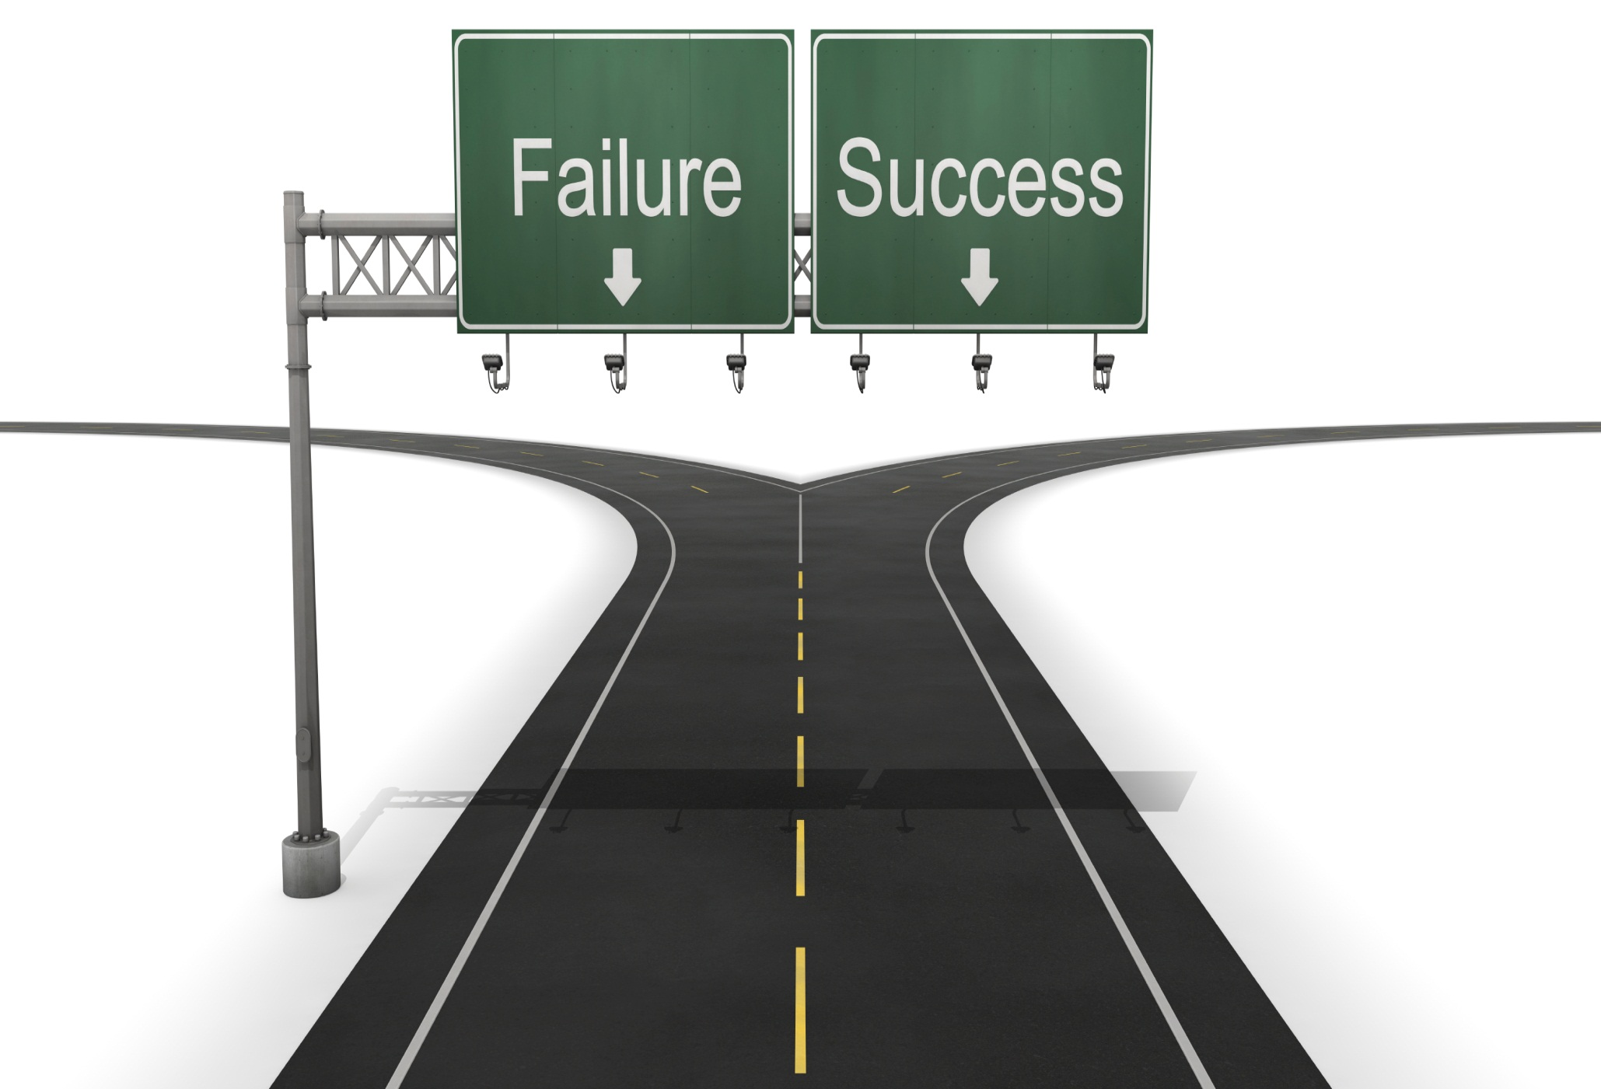
Who We Are
Who is Cornerstone International Group
Top executive search network 70 offices globally.
25 years of successful service to our clients and candidates worldwide.
Cornerstone is a global recruiter and developer of talent & a global Member of the (AESC).

Slide 17
New Members added so far 2014
Completed 5 so far :
Bangkok of Thailand
Prague of Czech Republic
Mexico City of Mexico
Miami and Milwaukee of USA
In Final Process / Due Diligence
Geneva
Amsterdam
Lyon & Paris
In Consideration
Dallas & Houston
New York
Singapore
Tokyo

Slide 18
100 offices by 2020 - Where Are The Gaps
• Algeria • Argentina • Australia • Austria • Albania • Armenia • Azerbaijan • Belgium • Brazil • Bulgaria • Bosnia & Herzeg. • Central America (Guatemala, Panama & Caribbean )• Chile • China • Colombia • Croatia • Czech Republic • Denmark • Egypt • Estonia • Finland • France (additional cities) • Germany (additional cities) • Greece • Georgia • Hong Kong • Hungary • India • Ireland • Israel • Italy • Indonesia • Japan • Kazakhstan • Latvia • Lithuania • Luxembourg • Macedonia • Mexico • Morocco • Malaysia • Moldova • Montenegro • Myanmar • Netherlands • New Zealand • Nigeria • Norway • Pakistan• Peru • Philippines • Poland • Portugal • Romania • Russia • Singapore • Slovakia • South Africa • South Korea • Spain • Sweden • Switzerland • Serbia • Slovenia • Taiwan • Tanzania Thailand • Turkey • UAE( Dubai) • UK • Ukraine • Uzbekistan • USA (additional cities)• Venezuela • Vietnam

Slide 19

World Network
World headquarters
  Shanghai, China
  Atlanta, USA
5 Operating regions
  Central and South Americas
  Europe, Middle East and Africa
  Asia Pacific
  USA
  Canada
  70 offices in 40 countries

Slide 20
Our Global Offices
Cornerstone Offices
Global Headquarters
20

Slide 21
Cornerstone International Group
Providing -More Reasons To Call As Trusted Advisors
Proactive - Client do not come to us, WE FIND THEM

Slide 22

Keep Smiling and Hands On Works
Website：www.cornerstone-group.com

Slide 23
Let us help each other to
Achieve More

