Slide 1

Subject :

Slide 2
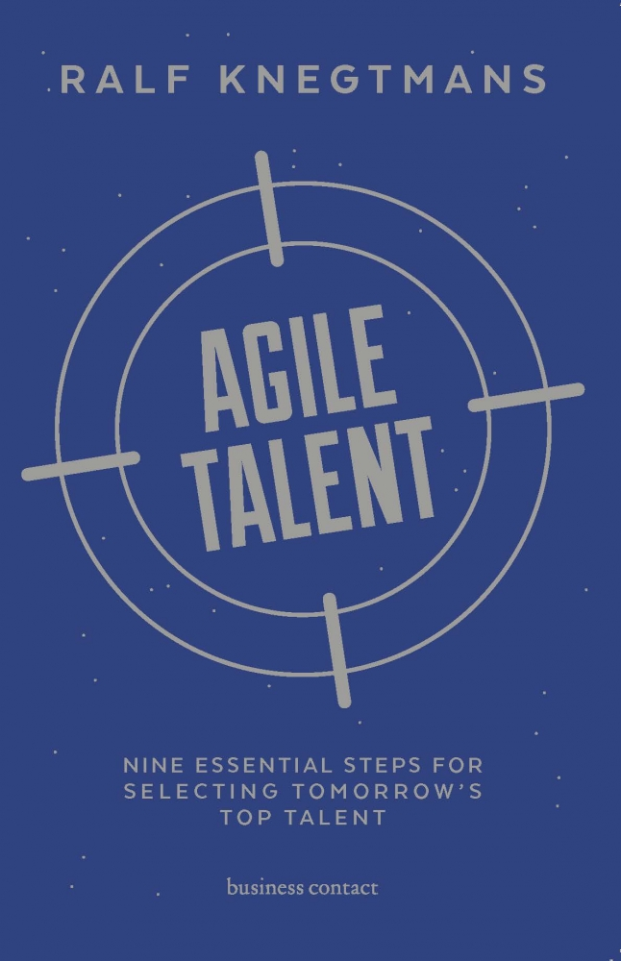
RALF KNEGTMANS
AGILE
TALENT
9 ESSENTIAL STEPS FOR
SELECTING TOMORROW’S
TOP TALENT

Slide 3
_____________________________________________________
“70% of today’s high performers lack critical attributes essential to their success in future roles.”
JEAN MARTIN AND CONRAD SCHMIDT, HARVARD BUSINESS REVIEW
______________________________________________________________

Slide 4
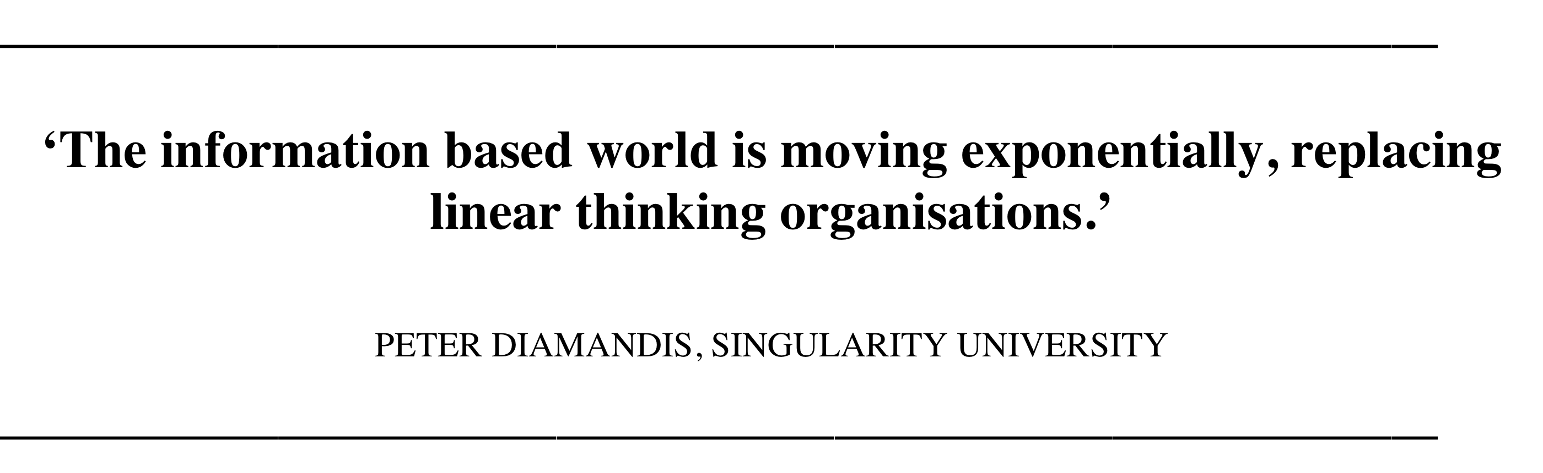
What’s going on in our world?

Slide 5
The average life span of companies is shrinking rapidly
1950 ➔ 45 years on average
Today ➔ 10 years
Future ➔ 5 years

Slide 6
Questions / Topics in our Book
The world is changing rapidly; if we as companies do not wish to become the next Kodak or Nokia, we need to be able to continuously adjust.
What are the selection criteria for future-proof talent, which will allow companies to achieve the objectives of tomorrow?
How can we structure our selection process in order to have a better predictability of future success of our targeted candidates (more objective & quantifiable)?

Slide 7
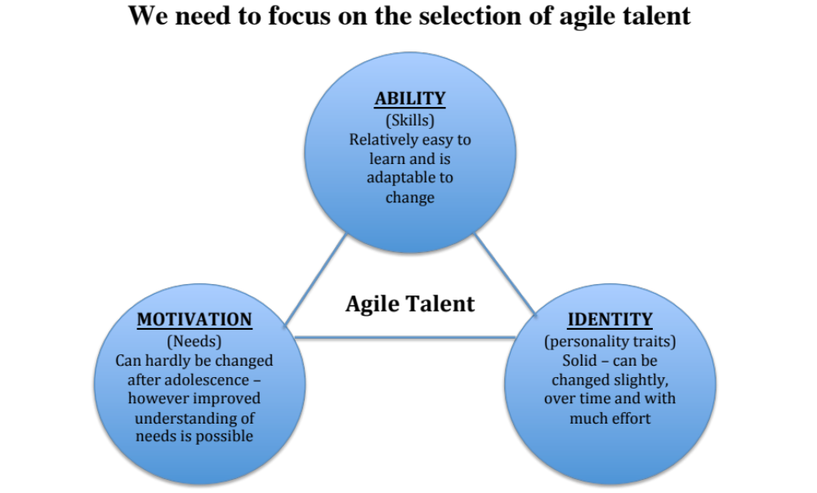

Slide 8
__________________________________________________
CURRENT SELECTION CRITERIA:
__________________________________________________
COMPETENCIES
DIPLOMA’S IQ & EQ
RIGHT BRAIN ACIVITIES
EXPERIENCE
KNOWLEDGE

Slide 9
____________________________________________________
IMPORTANT SELECTION CRITERIA FOR AGILE TALENT:
____________________________________________________
RIGHT & LEFT BRAIN
ANALYTICAL SKILLS
SELF REFLECTION PASSION
ADAPTABILITY REDUCING COMPLEXITY
HUNGER FOR FEEDBACK
INTUITION LEARNING ABILITY
CREATIVITY
IQ, EQ & AQ
CURIOSITY RESILIENCE
ACHIEVEMENT MOTIVE

Slide 10
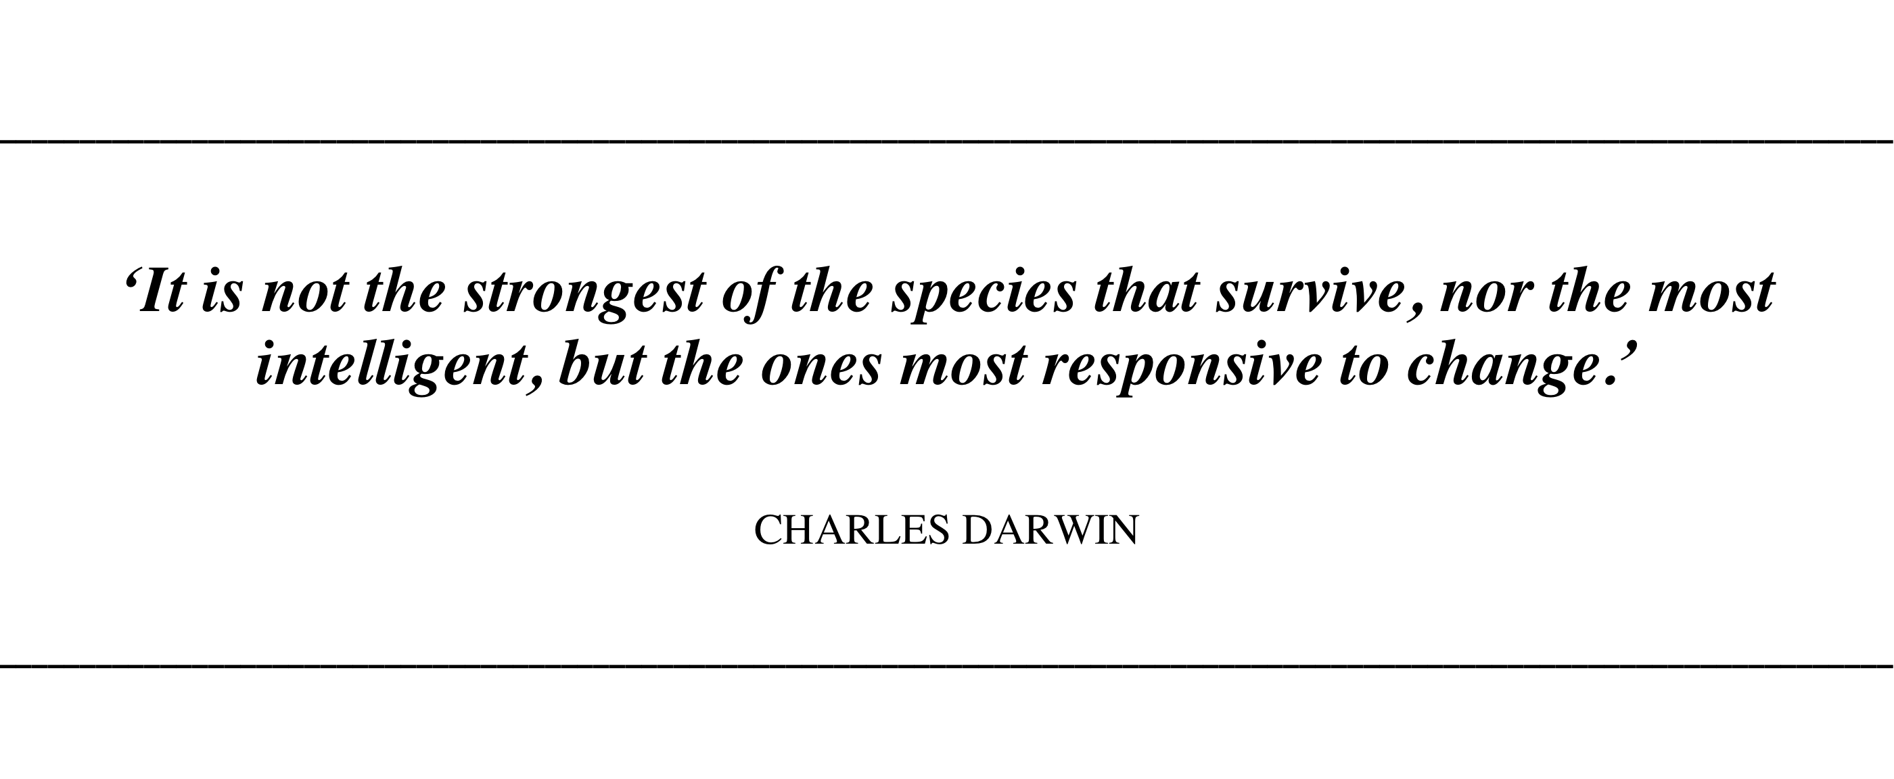
We will face a combined “shift” from IQ, EQ to AQ.

Slide 11
STAGE 1: PREPARATION
1
Take the context into account
2
Select based on
Ability, motivation and identity
3
Make the selection objective and quantifiable
4
Use a weighted feedback form
STAGE 2: SELECTION
5
Scan the candidate’s background
6
Examine his/her learning agility
7
Get the candidate to leave his/her comfort zone
STAGE 3: VERIFICATION
8
Carry out valid testing
9
Conduct meaningful reference checks

Slide 12
Benefits and side effects:
A significant increase in pitches that were won
Even the main global competitors (EZI, Russell, Spencer Stuart etc.) do not have a book that describes their approach in full detail.
Using the criterium based interview with a feed back form (p. 186 & 187) not only allows us to assist our customers in making better selections and in being more objective, it also increases the perceived added value of every Cornerstone Member!

Slide 13



