Slide 1
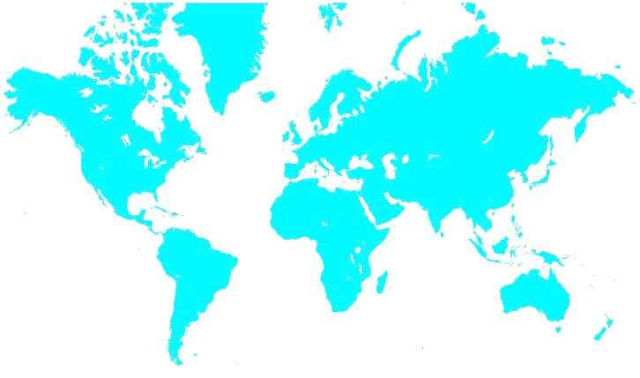

Aerospace & Defense Practice Group
Executive Search Service Introduction
Welcome to
Cornerstone International Group

Slide 2
Who We Are
Top executive search network 70 offices globally.
25 years of successful service to our clients and candidates worldwide.
Cornerstone is a global recruiter and developer of talent

Slide 3

World Network
World headquarters
  Shanghai, China
  Atlanta, USA
5 Operating regions
  Central and South Americas
  Europe, Middle East and Africa
  Asia Pacific
  USA
  Canada
  70 offices in 40 countries

Slide 4
Our Global Offices
Cornerstone Offices
Global Headquarters
4

Slide 5

A & D Sector
Why Cornerstone ?
The status quo of larger global networks restrict the search universe and quality.
Our consultants are hands on and lead the project personally.
Our experience in the local market and the industry offer the power of perspective, bring a diverse view and cast a wider net for standout candidates who will help you excel today, tomorrow and into the future.
To get there, we go beyond conventional wisdom

Slide 6
A & D Sector
Why Cornerstone ?
Cornerstone is Globally Organized
Cornerstone is Locally Present
Likewise is the Business of A&D&S that Follows the Local Needs for Government and Commercial Budgets.

Slide 7
A & D Sector
Why Cornerstone ?
Every Cornerstonian who Approaches A&D&S Needs to Know:
  As much as possible what A&D&S is about,
  What has Cornerstone done in A&D&S in the different Areas/Countries.

Slide 8
A & D Sector
Why Cornerstone ?
To achieve what in the above 2 slides we need:
  One Focal Point for co-ordination,
  Every Consultant to map A&D&S Industry in his/her area,
  Construct the list of relevant A&D&S Companies of Interest,
  Distribute this Information to the Network via the Focal Point,
  Assumption: will take 2 to 3 months to do the above.

Slide 9
A&D&S Sector
What is it About
A&D&S is a Capital Intensive Field of Industry,
Large Investment and Long Time of Development,
Highly Structured Organizations,
Important Lobbying Activity,
Many Links to Foreign Politics.

Slide 10
A&D&S Sector
What is it About
Main segments of A&D&S:
  Naval,
  Aeronautics,
  Space,
  Defence,
  Security.

Slide 11
A&D&S Sector
Naval
Naval, Segments:
  Surface Craft,
  Naval Defence Systems,
  Underwater Craft,
  Torpedo.

Slide 12
A&D&S Sector
Aeronautics
2. Aeronautics, Segments:
  Fixed Wing, Military and Commercial,
  Rotary Wing, Military and Commercial,
  Fixed and Rotary Wing UAV,
  Avionics,
  Missile.

Slide 13
A&D&S Sector
Space
3. Space, Segments:
  Launching,
  Space Navigation System,
  Space Telecom.

Slide 14
A&D&S Sector
Defence
4. Defence, Segments:
  Land, Fixed and Mobiles,
  Weapon Systems,
  Ordnance & Ammunition,
  Missiles,
  Torpedo.

Slide 15
A&D&S Sector
Security
5. Security, Segments:
Sensors & Recording Audio & Visual,
Secure Communication Systems,
Electronic Warfare,
System Integration.
Note: This is an increasingly sensitive field of activity.

Slide 16
A&D&S Sector
Top 15 Players
1. A&D&S Total, Top 15 (Sales in $B), slide 1.
  Boeing, 82
  EADS, 75
  Lockheed Martin, 47
  General Dynamics, 32
  United Technologies, 29

Slide 17
A&D&S Sector
Top 15 Players
2. A&D&S Total, Top 15 (Sales in $B), slide 2.
  Northrop Grumman, 28
  Raytheon, 24
  Finmeccanica, 20
  General Electric, 20
  Safran, 16

Slide 18
A&D&S Sector
Top 15 Players
  Note: The figures in the above 3 slides come from a report of Price Waterhouse Cooper, 2014.
  (www.pwc.com/en_GX/gx/aerospace-defence-and-security)

Slide 19
A&D&S Sector
Players in Italy, 1
Finmeccanica Group:
AgustaWestland, Rotary Wing,
Alenia Aermacchi, Fixed Wing,
WASS, Torpedo,
MBDA, Missile, (*)
Thales-Alenia Space Systems (*)

Slide 20
A&D&S Sector
Players in Italy, 2
  Finmeccanica Group (continues)
  Oto Melara, Weapon Systems,
  Selex ES, Security,
  DRS Technology, Security & Intelligence,
  Elettronica, Electronic Warfare. (*)
  (*) Limited Ownership)

Slide 21
A&D&S Sector
Players in Italy, 3
  Oerlikon Contraves, Fire Control Systems,
  Mecaer, Landing Gears and Interiors,
  Magnaghi, Landing Gears,
  Avio (GE), Aero Engines,
  Piaggio, Fixed Wing Aircraft.

Slide 22
Our Key Strengths
The Key Strengths of Cornerstone:
  World Wide Offices in the Network,
  Deep Experience of Consultants,
  Easy, Open and Friendly Communication Amongst Consultants,
  Dual Strong Management Poles in Shanghai and Atlanta.

Slide 23
Our Weakness
The Weakness of Cornerstone:
  Not Yet Recognized as an A&D&S Partner,
  Little Lobbying Capacity Locally,
  In Many Countries Low Level of Executive Searched,
  Need to Construct a Reference for High Level Search.

Slide 24
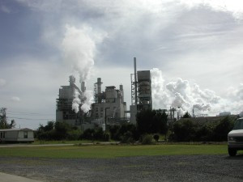


Aerospace and Defense Practice Group Credentials
Placed Country Executives, Vice Presidents, General Managers, Managing Directors, Human Resource Directors, Human Resource Managers, Supply Chain Managers, Quality Managers and Senior Managers for industrial companies

Slide 25

Contact Us for more info
Global Practice Head : Giuseppe Campellone,
giuseppe-campellone@cornerstone-group.com
Website: www.cornerstone-group.com

Slide 26
Let us help you to
Achieve More

