Slide 1


Sharing of
Cornerstone CEO Connection (CCC)
James Ng
Cornerstone CCC Practice

Slide 2
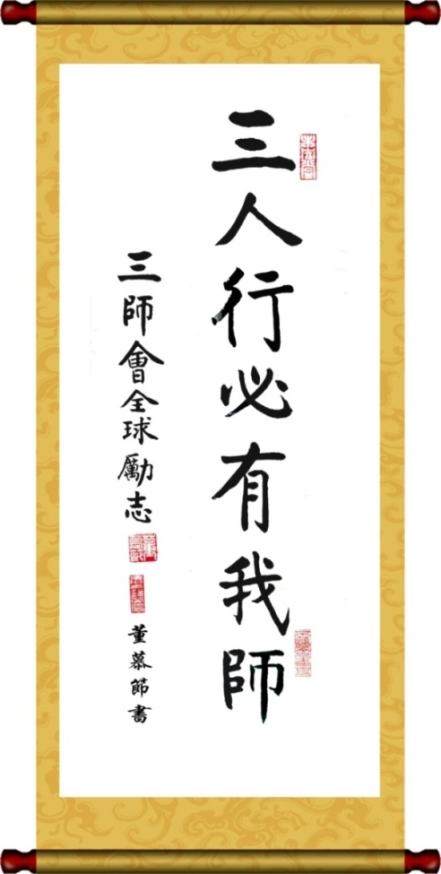
CCC
Cornerstone CEO Connection
Name
CCC’s Mission is to promote
‘Healthier Businesses and Lives’
Purpose
& Value
Know How
Know Who
Know Self
Practical Insights
Peer Networks
Peer Advisory & Coaching
Customer
Value Propositions
(CCC events and Networks, Peer advisory boards, coaching)

Slide 3
Current Update
Network of 1200 Business Owners / CEOs/C-Level (MNC & Locals)
120 Events (CEO Advisory Boards , HRD Breakfasts, Industry Breakfasts)
3 Global Summits : 2015 June (80 guests), 2015 Oct (100 guests) , 2015 Apr (120 guests)
Collaborators : ICLIF, SAP, EMLYON, CBN News, CEO Life, Deloitte..
Commercial Opportunities
Event Sponsors : Omnicom / DAS , Kedge, Secret Recipe, Zing Mobile…
Annual Fees (Peer Advisory Boards USD10K , Corporate Members USD 2K)
Executive Search (Clients and Talent Pools): CEOs / Directors (USD100K-300K)
Executive Coaching : GMs/Directors (Tailored)
Team Coaching (Sanofi, Schindler etc)
Others : AMCHAM Joint-Training , English Training , Tailored Programs (Happy Bee
Sanofi, Analogy, ICF Certification)

Slide 4
NICE Approach
Name : International brand NAME, stronger leverage in China and increase opportunities Awareness & Associations
International : Global Presence, increase interest to join the networks and increase opportunities
Credibility : A credible organization with 25 Years of Track Records. Company / Facilitators / Coaches endorsed/certified by AESC and ICF
Engagement : Engaged participants from diverse background to network as well as with CCC and Cornerstone for further business potential , applying KKK concept (Know How, Know Who, Know Self )

Slide 5
NICE Approach
Name : International brand NAME, stronger leverage in China and increase opportunities Awareness & Associations
International : Global Presence, increase interest to join the networks and increase opportunities
Credibility : A credible organization with 25 Years of Track Records. Company / Facilitators / Coaches endorsed/certified by AESC and ICF
Engagement : Engaged participants from diverse background to network as well as with CCC and Cornerstone for further business potential , applying KKK concept (Know How, Know Who, Know Self )

Slide 6
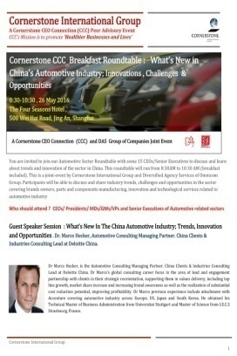
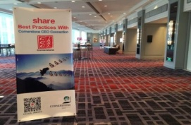
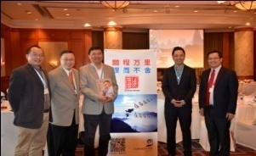
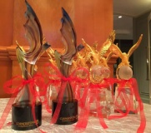
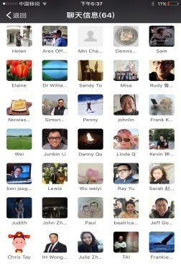
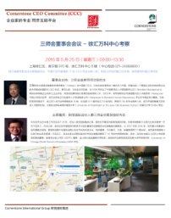
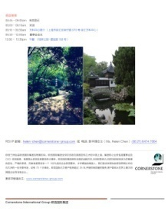
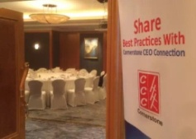
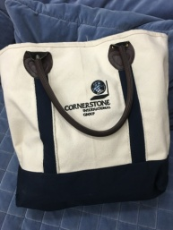
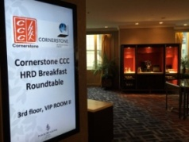
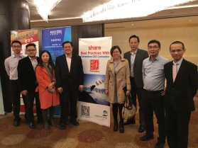
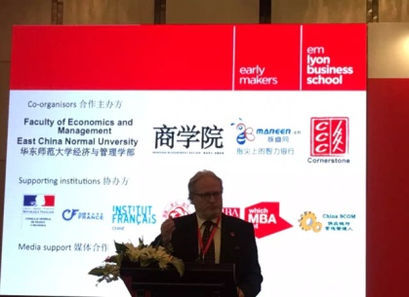
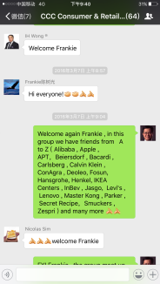
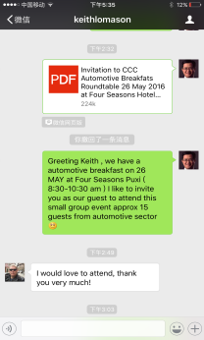
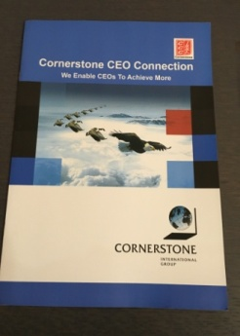
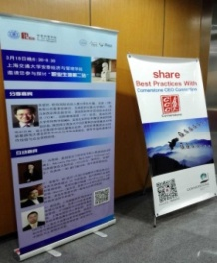
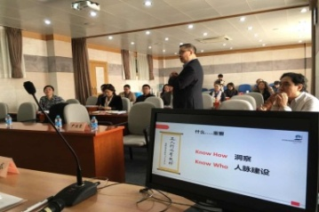
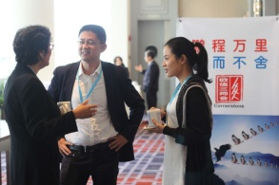
NICE
360 Brand NAME Exposures
Social Media
Before Event
During Event
After Event
Social Media

Slide 7



























NICE
Strong Brand Associations
Partners / Speakers / Paid Sponsors
Invited Panelists / Guests
President Circle

Slide 8




集团介绍
Cornerstone Global Leadership Summit
Market Outlook - Second Half 2016
欧信全球领导力峰会
2016 年 下半年趋势
The Four Seasons Hotel, Shanghai
13 April 2016
上海 - 四季酒店
2016年4月13日

Slide 9












Positioning (Premium, CEO/C-Suite)
Why invest in network beyond your own circle ？为何投入不同的脉圈子 ？
Grave Yard
Star
Brand Awareness
(Know, Recall)
Start up
Niche
Edsel
Brand Strength ( Association / Relevance / Favorability)
Adapted from A Aaker’s Brand Equity

Slide 10
NICE Approach
Name : International brand NAME, stronger leverage in China and increase opportunities Awareness & Associations
International : Global Presence, increase interest to join the networks and increase opportunities
Credibility : A credible organization with 25 Years of Track Records. Company / Facilitators / Coaches endorsed/certified by AESC and ICF
Engagement : Engaged participants from diverse background to network as well as with CCC and Cornerstone for further business potential , applying KKK concept (Know How, Know Who, Know Self )

Slide 11
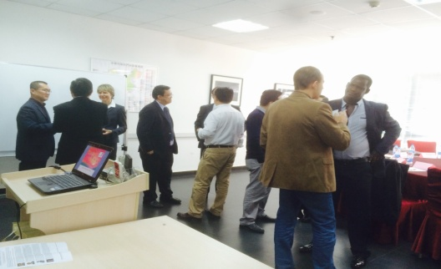
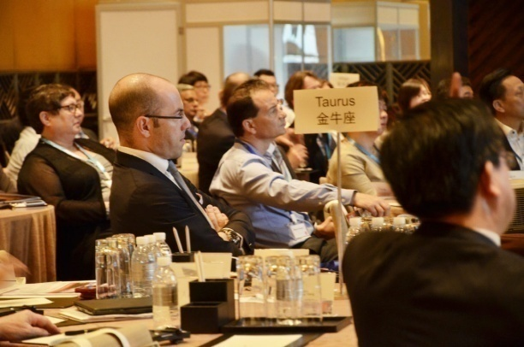
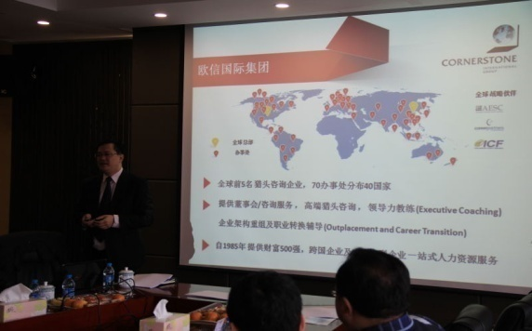
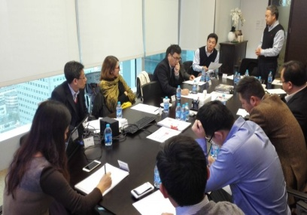
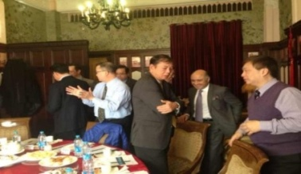
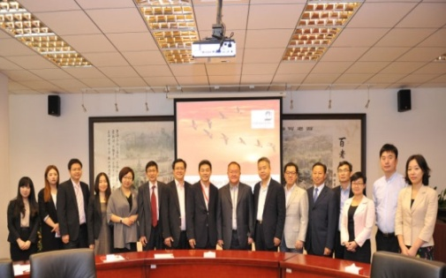
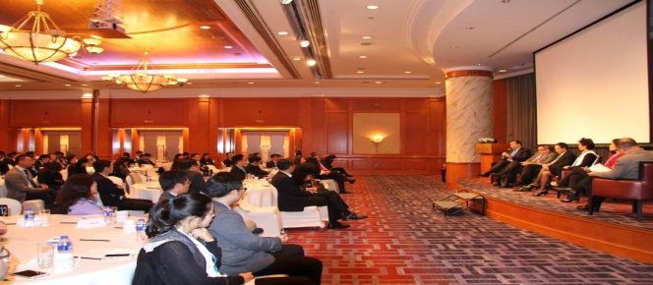
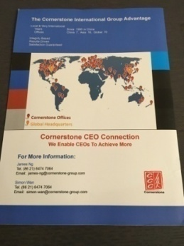
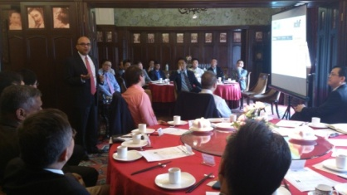
NICE
International : Presence 70 offices & 40 countries (MNC + Locals)
English
Mandarin
English + Mandarin
Promote Global Presence

Slide 12
NICE Approach
Name : International brand NAME, stronger leverage in China and increase opportunities Awareness & Associations
International : Global Presence, increase interest to join the networks and increase opportunities
Credibility : A credible organization with 25 Years of Track Records. Company / Facilitators / Coaches endorsed/certified by AESC and ICF
Engagement : Engaged participants from diverse background to network as well as with CCC and Cornerstone for further business potential , applying KKK concept (Know How, Know Who, Know Self )

Slide 13


NICE
25 Years track records (awards, recognition)
AESC Endorsement (global affiliation, quality and professionalism, ethical standards)
Appointed facilitators, coaches certified by ICF (ethical standards, professionalism)

Slide 14
NICE Approach
Name : International brand NAME, stronger leverage in China and increase opportunities Awareness & Associations
International : Global Presence, increase interest to join the networks and increase opportunities
Credibility : A credible organization with 25 Years of Track Records. Company / Facilitators / Coaches endorsed/certified by AESC and ICF
Engagement : Engaged participants from diverse background to network as well as with CCC and Cornerstone for further business potential , applying KKK concept (Know How, Know Who, Know Self )

Slide 15
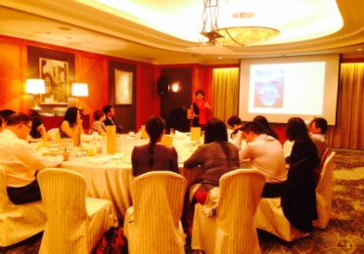
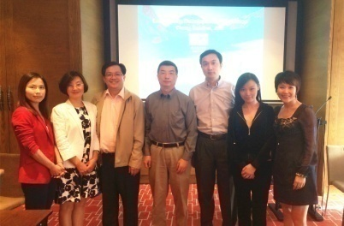
Attending CCC always a NICE (unique & WOW) Experience
Planned Funnel
Sitting Plan
Actual Experience
Pool , Active Interactions
(Data Base, Networks, Linkedin)
Target Profiles
(BD for CCC & Sponsors)
Host 2
Invitation
(Personalized)
BD Follow Up / Conversion
Acceptance
Final Attendance
Host 1

Slide 16
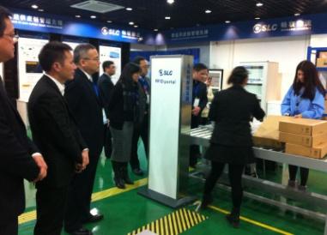
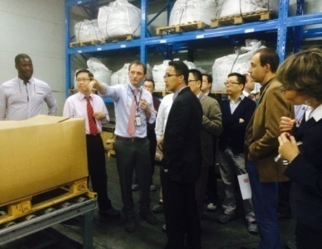
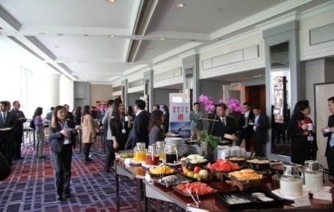
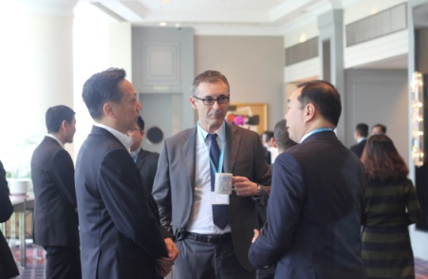
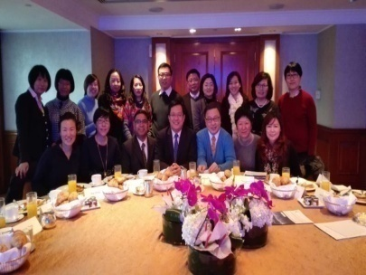
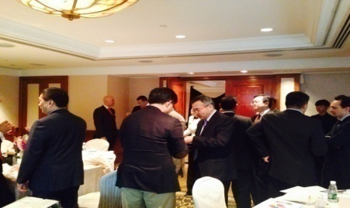
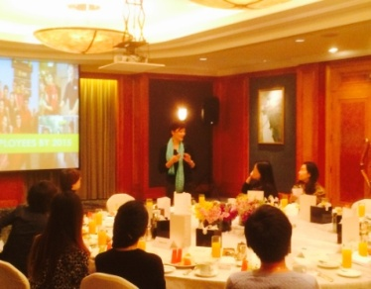
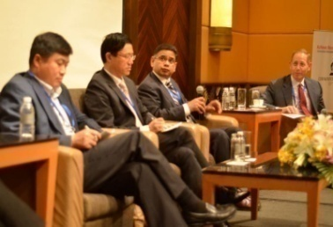
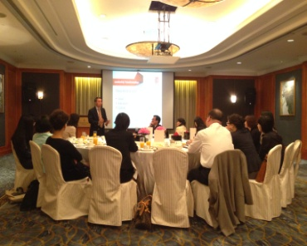
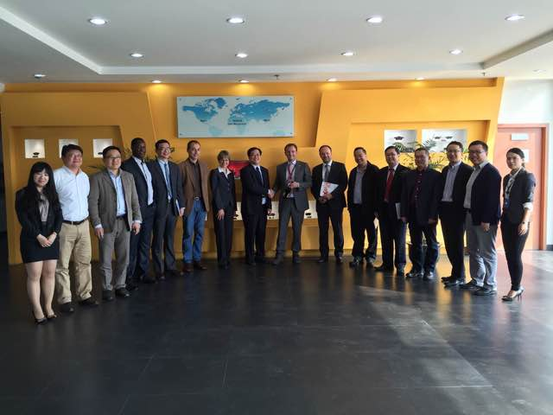
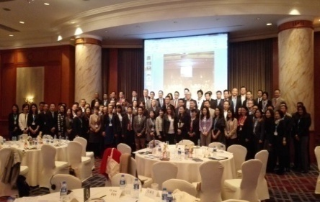
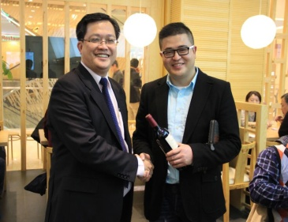
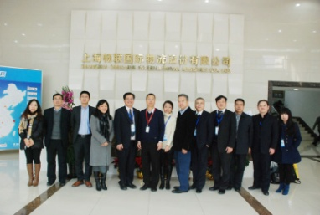

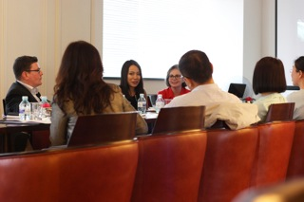
Engagement through KKK Model
Know How
(Peer Sharing + Insights)
Know Who
(Peer Networking, on/off lines)
Know Self
(Peer Advisory + Coaching)

Slide 17
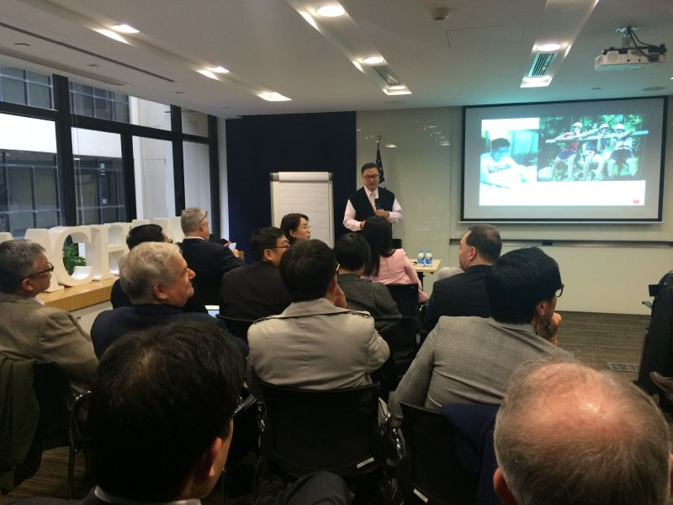
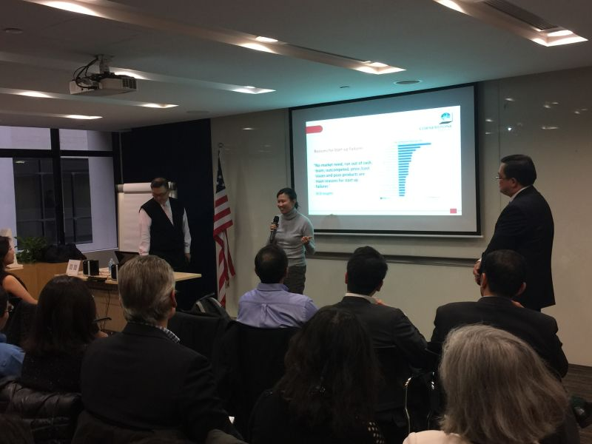
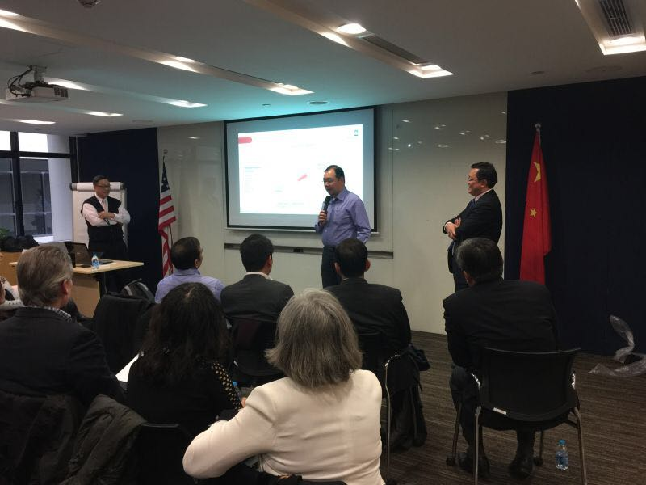
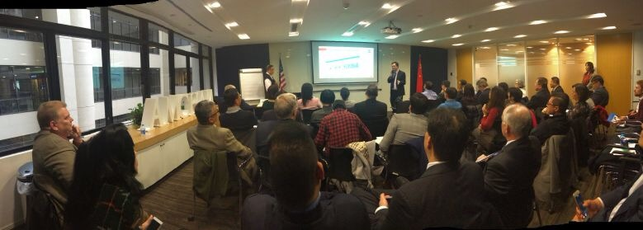
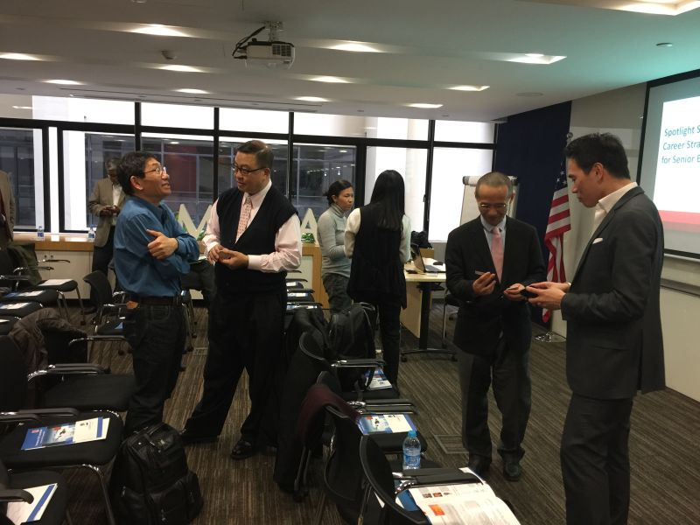
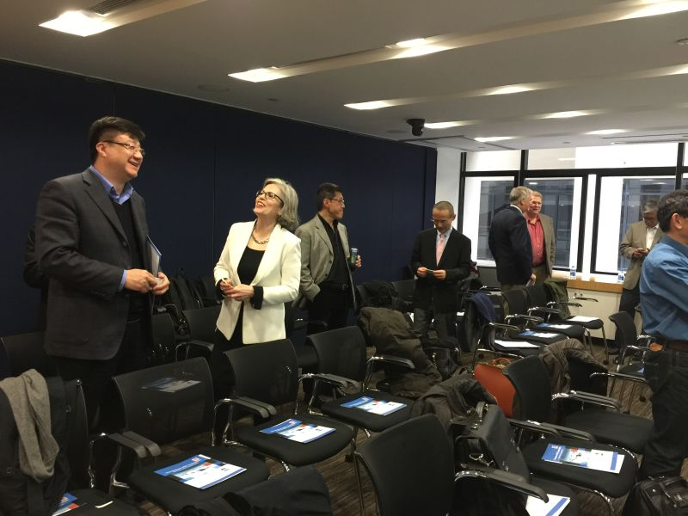
Career Strategies for Senior Executives (25+ years Experience) at
American Chamber of Commerce Spotlight Session (9 March 2016)
Profile: Simon Wan
Concepts (Know How + Know Self) )
Participants sharing own journey
Participants sharing own journey
Cases & Forward Plan
Networking / BD
Networking / BD

Slide 18


Know Who
Cornerstone Global Leadership Summit
Market Outlook - Second Half 2016
欧信全球领导力峰会
2016 年 下半年趋势
Cornerstone Global Leadership Summit – 2016 Second Half Year Outlook
The Four Seasons Hotel, Shanghai 13 April 2016
欧信全球领导力峰会 – 2016 下半年趋势，机遇与挑战 上海四季酒店， 2016年4月13日

Slide 19




Winter / Spring
Summer / Autumn
UNIQUE EXPERIENCE
Cornerstone Global Leadership Summit
Market Outlook - Second Half 2016
欧信全球领导力峰会
2016 年 下半年趋势
Cornerstone Global Leadership Summit – 2016 Second Half Year Outlook
The Four Seasons Hotel, Shanghai 13 April 2016
欧信全球领导力峰会 – 2016 下半年趋势，机遇与挑战 上海四季酒店， 2016年4月13日

Slide 20






Knowing New Friends
认识新朋友

Slide 21






Knowing New Friends
认识新朋友

Slide 22







Knowing New Friends
认识新朋友

Slide 23

BD : Commercial Value Proposition
What Does
Cornerstone CEO Connection (CCC) Do
1) Trusted Peer Advisory Group Mentoring, facilitated by a CEO Coach
2) 1-on-1 EXECUTIVE COACHING sessions
- Memberships, Tailored Programs, Public Programs
- Sponsors, Contributors

Slide 24
Moving Forward :
CCC Mission : Support C-Suite Community Achieving Success in businesses and Personal Lives.
CCC Enablers : Peer Advisory Boards and 1-1 Coaching
Execute through KKK Model
Active Networks of 5000 CEOs / C-Suite by 2020
Peer Advisory Boards (CEO, Executive, HRD)
Coaching Services (Executive, Career, Hi Potential, Tailored and Public Programs)
Collaborators Programs (Sponsors, Chairs & Facilitators, Coaches)
Beyond China

