Slide 1






MEET CORNERSTONE
We help to build great teams who go on to build great companies

Slide 2

LET’S START HERE….
Cornerstone International Group, with 60 offices in 40 countries (and growing) since 1989, is a global network of search and coaching specialists who help our clients to build great teams, so our clients can go on to build great companies.
Achieve more with Cornerstone.

Slide 3

1
WE’RE GLOBAL
We serve as trusted partners to clients big and small who have ambitions to grow locally or globally.

Slide 4
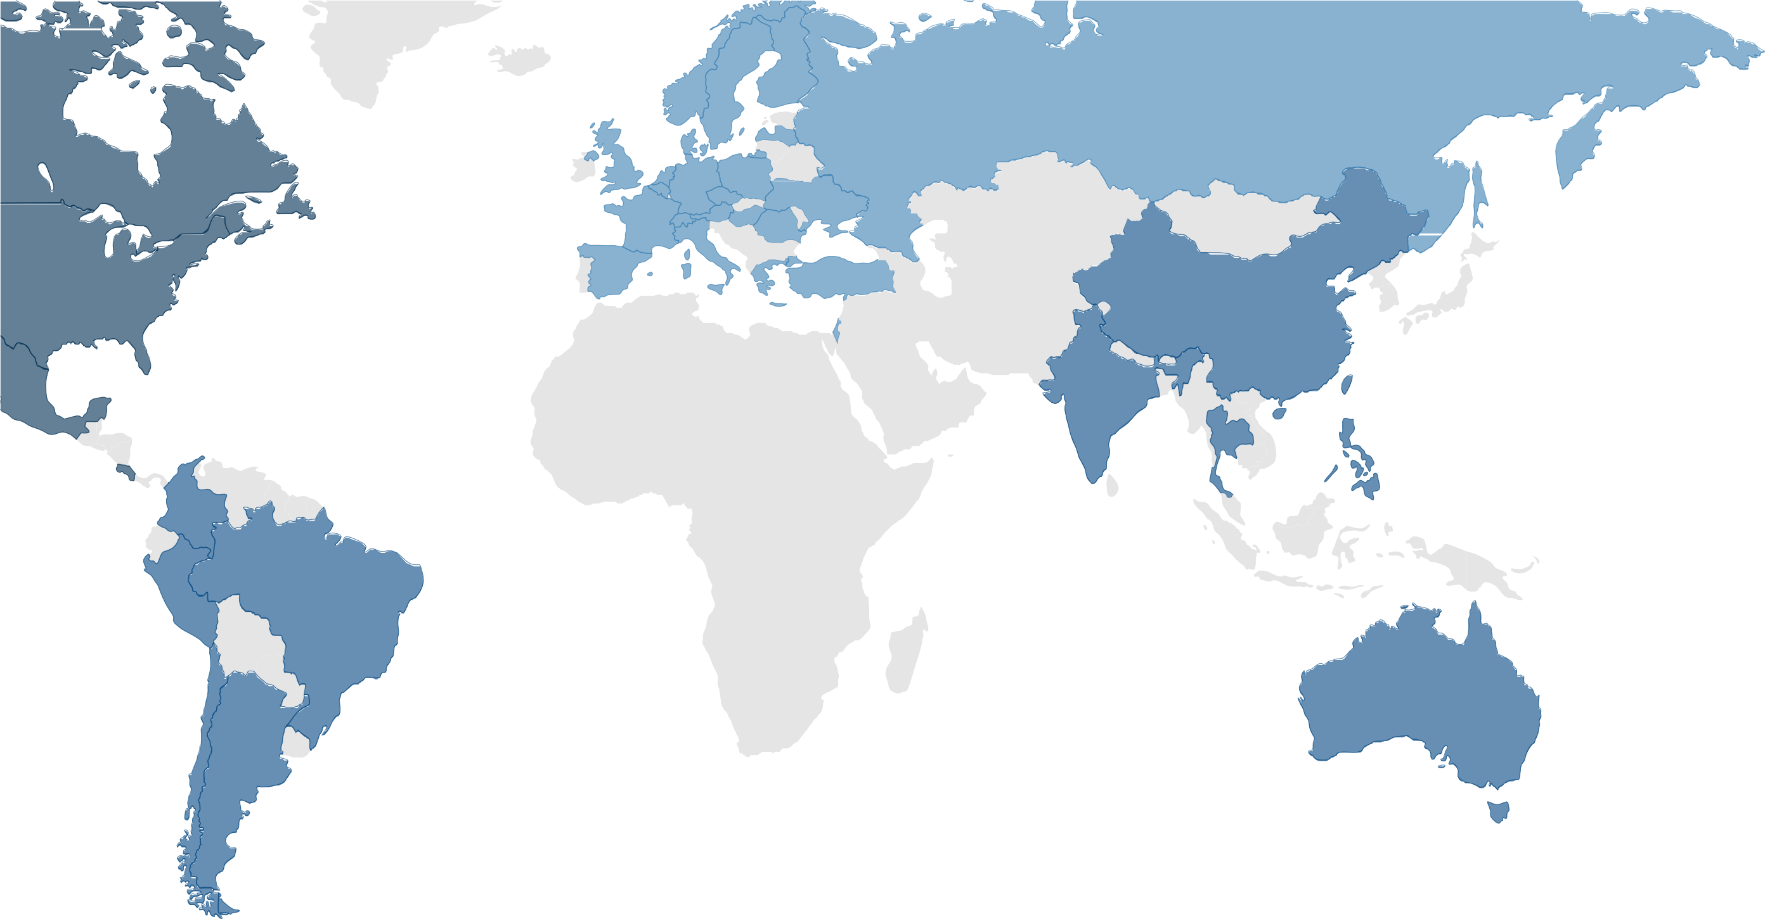
OUR GLOBAL REACH &
CAPABILITY
Austria
Belgium
Czech Republic
Denmark
England
Finland
France
Germany
Greece
Hungary
Israel
Italy
Netherlands
Norway
Poland
Romania
Russia
Spain
Sweden
Switzerland
Turkey
Ukraine
CHINA
Australia
India
Philippines
Singapore
Taiwan
Thailand
Argentina Brazil
Chile
Colombia
Peru
USA
Canada
Costa Rica
Mexico

Slide 5




PERFORMANCE
REPEAT BUSINESS 85%+
ANNUAL EXECUTIVE SEARCHES 1,050
STICK RATIO 90%+*
* NEW HIRE STILL IN PLACE AFTER 18 MONTHS
SCOPE
SCALE
GUARANTEE
Executive Search
Executive Coaching
Career Management
Leaders Brain Trust
500 C-level engagements per year
250 executive search professionals
100 certified coaches
- No-fee replacement if failure due to fit or competence

Slide 6

2
WE’RE SPECIALIZED
We find, develop and support just one kind of person.
The one you need.

Slide 7





WHO IS THAT PERSON?
Aligns with your culture and goals
Has the required skills and experience
Generates value and growth
Has the potential to grow
Shares your vision

Slide 8


Retained Executive Search
and key position recruitment
Executive Coaching
maximizing talent and accelerating ROI
SERVICES
ACROSS CORNERSTONE
Workforce Management
Career development & transition management
Leaders’ Brain Trust
New insights & multi-program mentoring

Slide 9
SERVICES WHAT IS BEHIND THEM
We accelerate your success through top-quality consulting services for talent recruitment and development
We know how to help you attract the leaders you need for your business
Our work is validated by Forbes as one of the Best Management Consulting Firms in Executive Search for the past four years
We don’t quit until you are satisfied

Slide 10







SPECIALIZATIONS by Function
Human Resources
Finance & Legal
CEO & Board
Operations & Supply Chain
Sales & Marketing
Agile Talent

Slide 11







SPECIALIZATIONS by Industry
Life Sciences & Health
Financial/ Fintech
Non-Profit
Technology
Industrial
Consumer
Infrastucture

Slide 12

3
WE’RE RECOGNIZED
We have been listed by Forbes every year since 2016

Slide 13
AWARDS
Top 20 America’s Best Executive Search firms 2017 by Forbes
Top 10 Global Management Consulting Firm in Executive Search 2016 by Forbes
Global 30 list by Hunt Scanlon 2019, 2020
Most Trusted China Recruitment Firm

Slide 14

4
HOW YOU BENEFIT
Hiring the right person is tricky and critical. Missing one key step can have costly and unwelcome results. We cover all the steps.

Slide 15




CRITICAL COMPETENCIES
Reach
Experience
Trust
Knowledge
Performance
Local knowledge with global capability. Your bridge to top talent in unfamiliar markets
Senior, motivated search professionals with industry experience
Over 85% of our business is repeat.
When you hire us, you gain a trusted partner.
Over 250 search professionals and 100 coaches share best practices
90%+ success ratio & with
engagement guarantee

Slide 16


Simon Wan, Chairman & CEO (SHANGHAI)
simon-wan@cornerstone-group.com
Larry Shoemaker, President (ATLANTA)
larry-shoemaker@cornerstone-group.com
Laurie O’Donnell, Executive Coaching
laurie-odonnell@cornerstone-group.com
Nance Macleod, Career Management & Brain Trust
nance-macleod@cornerstone-group.com
Goran Jansson, EMEA
goran-jansson@cornerstone-group.com
Dan Heiman, North America
dan-heiman@cornerstone-group.com
Edwin Yeo, Asia-Pacific
edwin-yeo@cornerstone-group.com
Diego Cubas, Latin America
diego-cubas@cornerstone-group.com
OUR GLOBAL BOARD

