Slide 1

Marketing 2017

Slide 2
agenda
Yesterday
Today
Tomorrow
Notes:
We’ll take a quick look at 2016, 2017 and then where we want to go

Slide 3
Our Purpose
Internal
  Support member Business Development as Cornerstone
External
  Build awareness of CIG, its values & service offer
Notes:
Just a reminder that we try to fill two needs.
Helping you to build business as Cornerstone
And building the brand

Slide 4
Performance update
 | 2016 (12) | 2017 (5)
Average visits per month | 6,935 | 6,706
Total Visits | 83,222 | 26,825
LinkedIn | 2,992 | 3,800
Blog posts | 35 | 12
CIG Authors | 14 | 7
Press releases | 7 | 2
Visitors from Trackerly | 5,907 | 1,013
Business Referrals # | 7 | 4
Business Referrals $ | $382,778 | $3,099
Direct form queries | 339 | 115
Notes:
Growth has flattened out only because we had less activity recently. That has changed
Linked in – growth of 27%
I’m very appreciative of the support from those writing blogs. Please keep it up
We’ve only just started tracking referrals and I’ll come back to Trackerly and form queries -
BTW – monthly reports on the Portal site in Resources

Slide 5
Performance update
 | 2016 (12) | 2017 (5)
Average visits per month | 6,935 | 6,706
Total Visits | 83,222 | 26,825
LinkedIn | 2,992 | 3,800
Blog posts | 35 | 12
CIG Authors | 14 | 7
Press releases | 7 | 2
Visitors from Trackerly | 5,907 | 1,013
Business Referrals # | 7 | 4
Business Referrals $ | $382,778 | $3,099
Direct form queries | 339 | 115
Notes:
Trackerly lets us put tracking codes on external content such as press releases

Slide 6
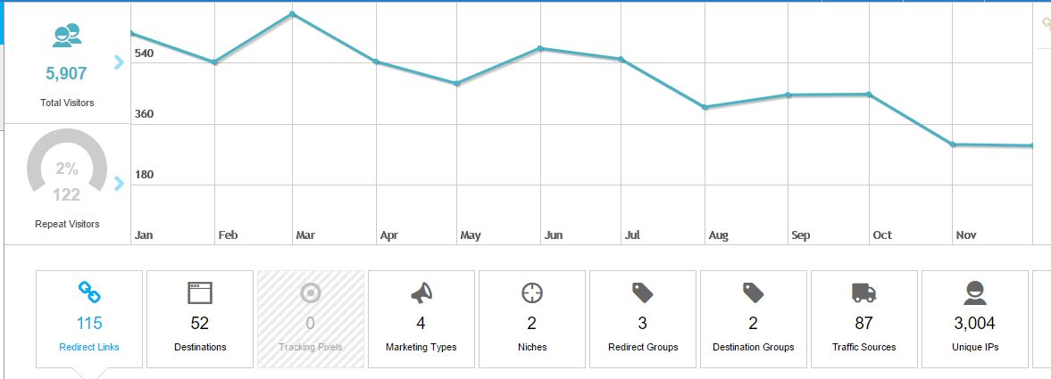
Power of compounding
5,907 visitors in 2016
From 115 links
1,102 visitors so far in 2017
From 1 link
Notes:
Here’s a trackerly report for 2016
It really illustrates compounding
5907 site visitors but we only issued 115 links. Rest from before old trackers still working hard
Same this year. Only one new link, but over 1,000 visitors

Slide 7
Performance update
 | 2016 (12) | 2017 (5)
Average visits per month | 6,935 | 6,706
Total Visits | 83,222 | 26,825
LinkedIn | 2,992 | 3,800
Blog posts | 35 | 12
CIG Authors | 14 | 7
Press releases | 7 | 2
Visitors from Trackerly | 5,907 | 1,013
Business Referrals # | 7 | 4
Business Referrals $ | $382,778 | $3,099
Direct form queries | 339 | 115
Notes:
Direct form queries have been a big success.
They average 29/month. The 115 was from the old system

Slide 8
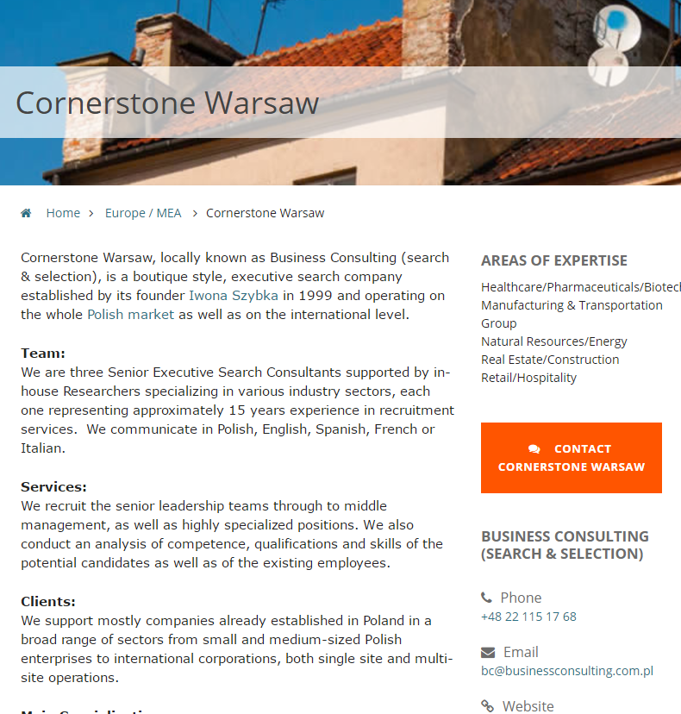
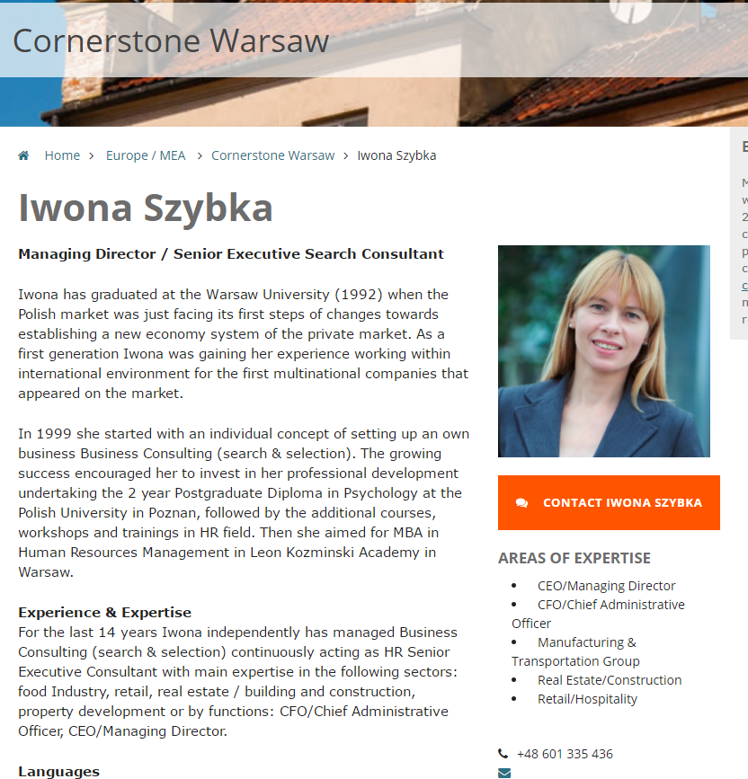
Direct Query Submissions
Notes:
I’m talking about the orange boxes that are on every office and consultant age.
The visitor just clicks the box and the query goes straight to the consultant or to a designate in the office.
A lot of them are from candidates, but there is a fair mix of leads

Slide 9
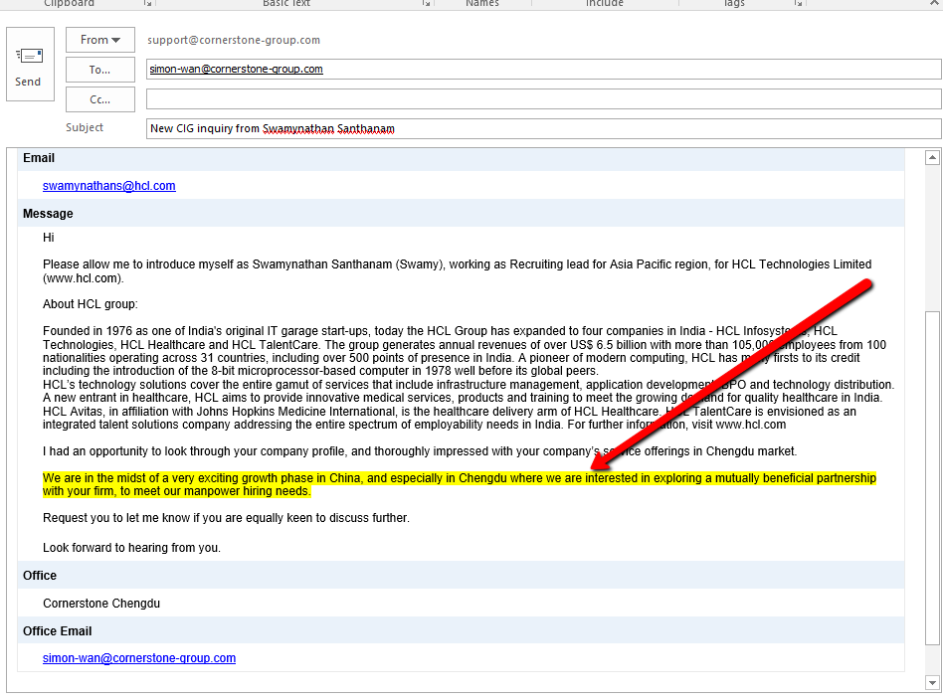
Site form submissions
Enquiry direct to Chengdu office.
“We are interested in exploring a mutually beneficial partnership with your firm, to meet our manpower hiring needs.”
Notes:
Here’s an example that went to Chengdu office
This is what the highlight says.

Slide 10
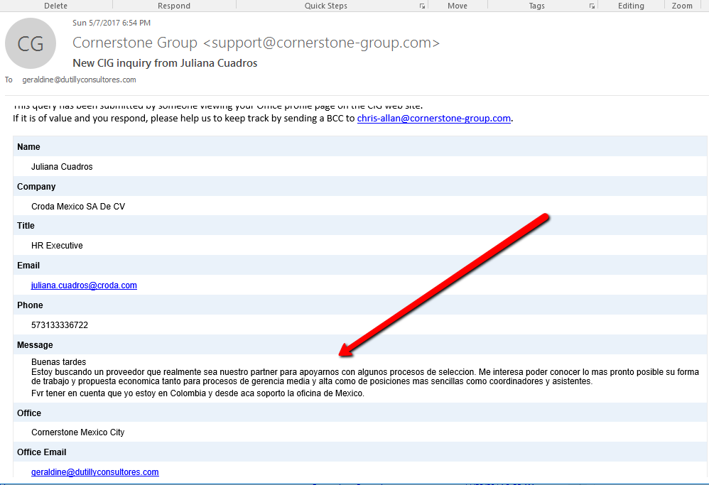
Site form submissions
Enquiry direct to Mexico City
``I am looking for a supplier that really is our partner to support us with some selection processes. I am interested in ……….both medium and high management positions as well as simpler positions such as coordinators and assistants.``
Notes:
Here’s another one to Geraldine

Slide 11
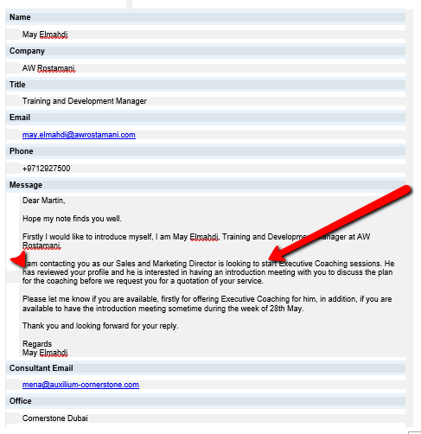
Site form submissions
Coaching Enquiry to Dubai
I am contacting you as our Sales and Marketing Director is looking to start Executive Coaching sessions. He has reviewed your profile and he is interested in having an introduction meeting with you to discuss the plan for the coaching before we request you for a quotation of your service
Notes:
This Marketing Director wants to meet Martin to discuss coaching after reading his profile on the website
Quick count roughly 20% are legitimate queres.
Out of 330 last year that’s 66 leads. Getting there..

Slide 12
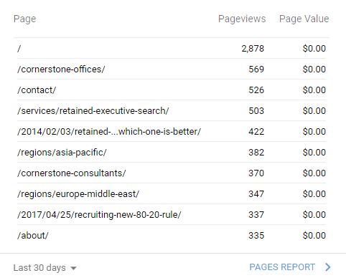
Google Analytics
“Where does everyone go?”
Notes:
Out of just under 3000 for the period
21% were looking at office prpfiles, 20% went straight to Contact and 19% wanted retaned search.

Slide 13
Where do They Go ?
Google Analytics over 30 days
Notes:
A four year old series on retained vs contingency is still drawing a steady 15-18% every month It is also a top rated article on Google

Slide 14
Where do They Go ?
Google Analytics over 30 days
Notes:
And a blog post by Larry drew 13% of visitors,

Slide 15
agenda
Yesterday
Today
Tomorrow

Slide 16
2017 to Date
Early year focus on site refresh
Practice Groups approaching launch
“Join Cornerstone” campaign
2017 Global Business Survey
Feature additions
  Recording and posting regional and PG calls on Member Portal
After Web 3.0
  Clean up Resources on Portal

Slide 17
Practice Groups
Ready for Prime Time
  Life Sciences & Health
In the Green Room
  Financial Services
  CEO & Board advisory
Still in Rehearsal
  Industrial

Slide 18
Practice Groups
Contacts
  Life Sciences & Health
    Dominic Yim | Geraldine du Tilly
  Financial Services
    Justin Mills | Lydia Goutas | Meg Bradt
  CEO & Board Advisory
    Simon Wan
  Industrial
    Larry Shoemaker

Slide 19
Join Cornerstone
Promo box and text on the website
Offer to send “11 Reasons to Join Cornerstone” (PPT)
Website promo and PPT downloadable from Member Portal

Slide 20
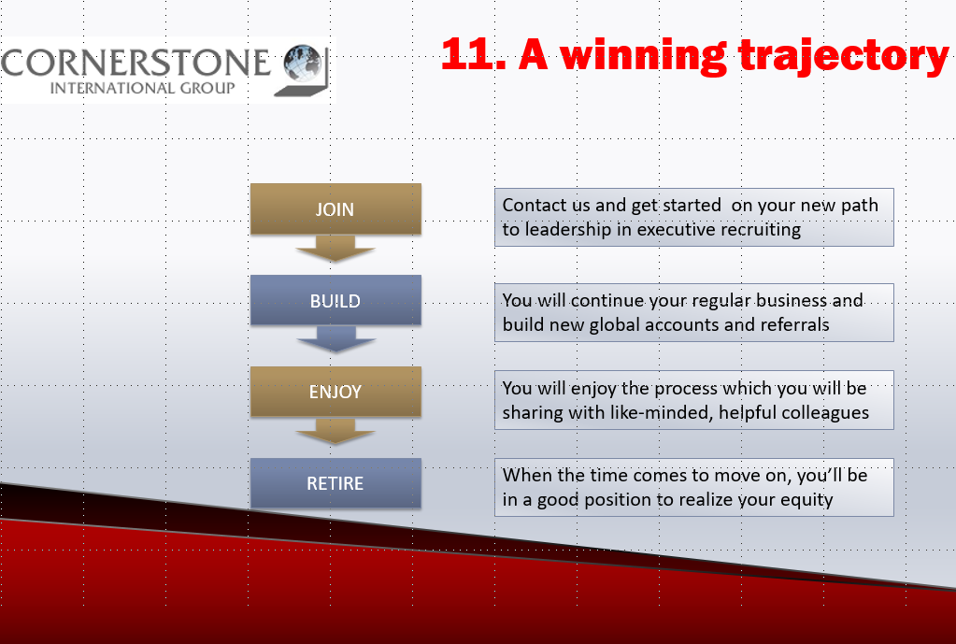
Those 11 Reasons
Globally Connected
Locally Managed
World Class
Superior Process
Best Practice Sharing
Specializations
Practice Groups
Growth Today
Growth Tomorrow
Succession
A winning trajectory

Slide 21

Global Business Survey
Subject “Employee Engagement”
Response rate below average
Member support below average
Report distribution May 22

Slide 22
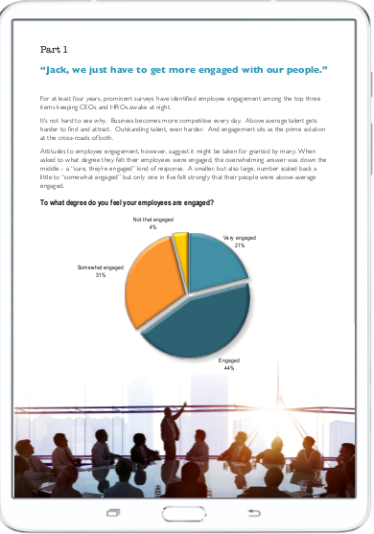
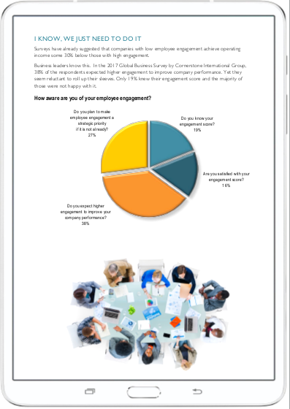

Slide 23
agenda
Yesterday
Today
Tomorrow

Slide 24
Tomorrow’s Challenge
  Awareness
  Value
  USP

Slide 25
Tomorrow’s Challenge
  Awareness
    Make ourselves better known
  Value
  USP

Slide 26
Tomorrow’s Challenge
  Awareness
    Make ourselves better known
  Value
    Communicating what the brand represents
  USP

Slide 27
Tomorrow’s Challenge
  Awareness
    Make ourselves better known
  Value
    Communicating what the brands represents
  USP
    Differentiating our offer

Slide 28
“Everybody’s Talking at Me”
Biggest challenge: Breaking Through the Noise
Notes:
Song from Midnight Cowboy
A few eeks ago, a chap called Paul Talbot C:\Users\chris\Documents\Cornerstone 2015\2017 Marketing\Madrid\Graphics\survey_page_2.pngive swrote a piece in Frobes about how executivesearch firms market themselves.
Calledd it Marketing with a muzzle.
Proof of performance hard to give so make promises. All sound the same

Slide 29
“Everybody’s Talking at Me”
Biggest challenge: Breaking Through the Noise
“.. with recruitment experts across the country, our broad reach delivers demonstrated search and hiring results for clients and candidates.”
Notes:
Could have been CIG. Was Lucas Group

Slide 30
“Everybody’s Talking at Me”
Biggest challenge: Breaking Through the Noise
“.. with recruitment experts across the country, our broad reach delivers demonstrated search and hiring results for clients and candidates.”
… our consultants are uniquely positioned to advise public and private client companies.”
Notes:
That could have been us too
It was Heidrich

Slide 31
“Everybody’s Talking at Me”
Biggest challenge: Breaking Through the Noise
“.. with recruitment experts across the country, our broad reach delivers demonstrated search and hiring results for clients and candidates.”
… our consultants are uniquely positioned to advise public and private client companies.”
…”We deploy consultants with the expertise and contacts to best support our search. We draw on our high-level professional networks, industry knowledge and internal research resources to identify the right people”
Notes:
Don’t think I know the last one.
Coud have been anyone and is that is the point

Slide 32

7 Opportunities to Differentiate
Product
Process
Technology
Price
Quality
Service
User Experience
Notes:
Talbot figures service firms had seven opportunities to differentiuate their offer.
Anyone volunteer which would work best for Corberstone ?

Slide 33
7 Opportunities to Differentiate
Product
Process
Technology
Price
Quality
Service
User Experience
Notes:
My money is on this one
Because I think it sums up everything before it.
I think ROI is the only proof of performance but that’s hard to get and takes several years.

Slide 34
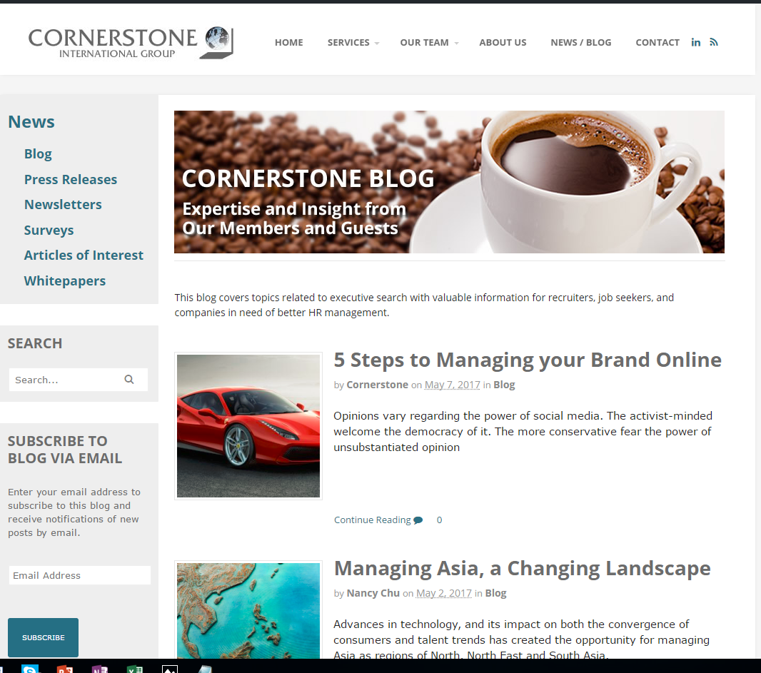

Hmm, we need a story……
Notes:
I have a story to illustrate yser experience.
Justin sent 5,000 word article. Etc

Slide 35

AL Control Laboratories
Safety tests in 11 countries
10 MM tests a year
1,400 employees
Transactional model losing ground
Strategic shift to revenue growth
Channel: service leadership

Slide 36
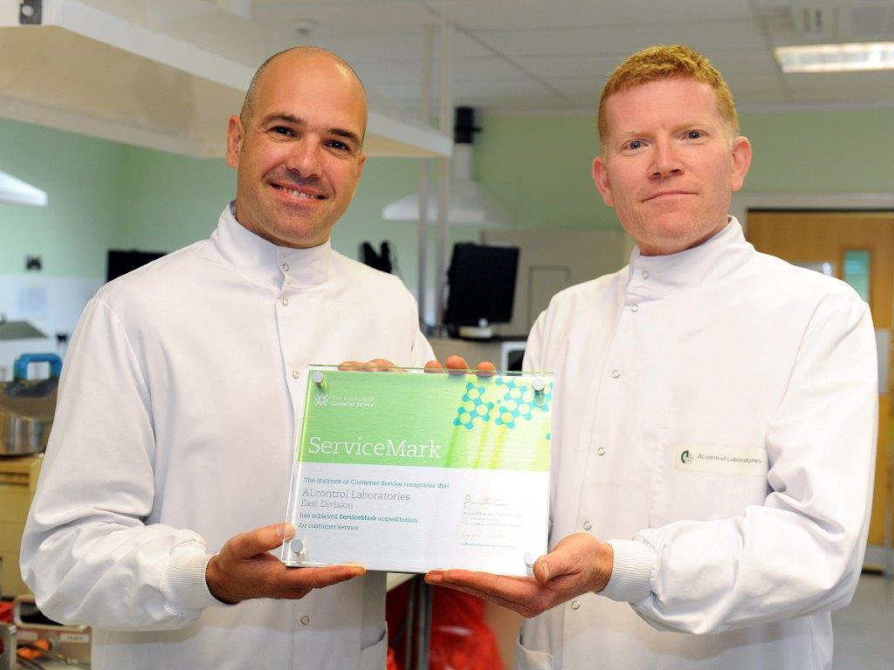
Cue Cornerstone London
MD Mike McCorkell approached Cornerstone London
Recruited:
  Cultural transition leader
  Sales Director
  3 more key hires
“The experience of partnering with a retained recruitment company over a long term helped to set up the success”

Slide 37

Strong Results - Client
Employee engagement 84%
Sales price +22%
Customer retention 95%
Profitability +10%
Successful sale of Division

Slide 38
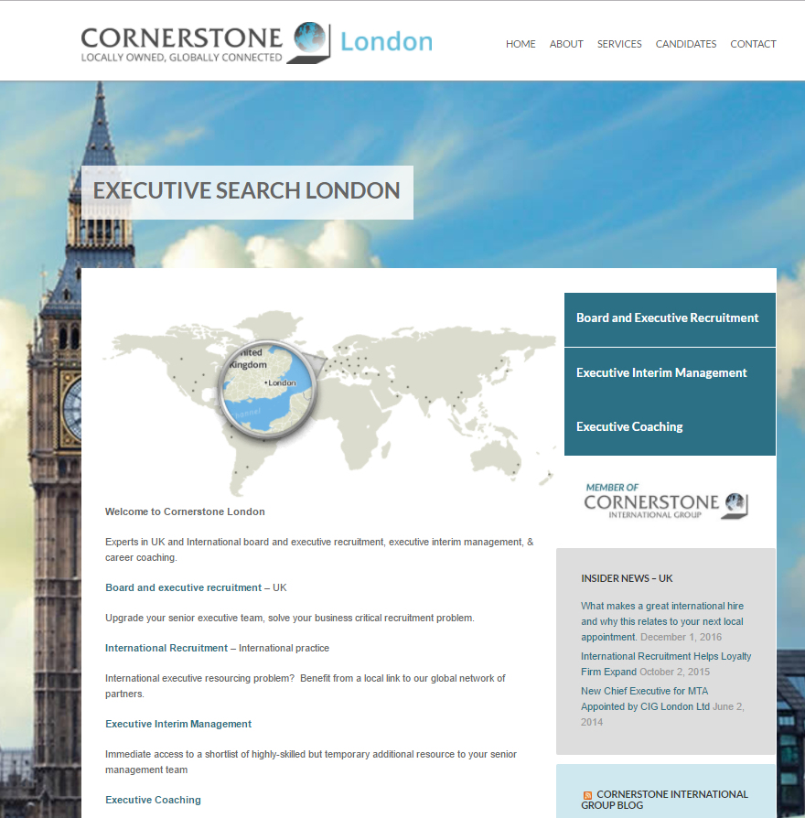
Strong Results – Cornerstone
Value of retained search reinforced
Importance of excellence in search and hire demonstrated
Value of Cornerstone recognized by client
Congrats to Justin & The Team!

Slide 39
Back to the Challenge
We’re playing in the big leagues
Our delivery channel is online, with a focus on the website
Our media is content
We have many stories to tell
Our drive is to showcase our own experience
Notes:
ARE YOU GETTING THE HINT HERE ?

Slide 40
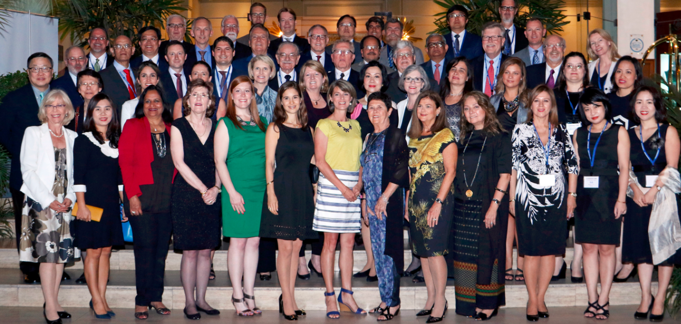
Ask Not What Cornerstone Can Do For You…..

Slide 41
Back to the Challenge
You have the knowledge and experience
Contribute a text, or even just a subject idea
What brought your client to you ?
You know it all – You just have to tell me !!
Notes:
ARE YOU GETTING THE HINT HERE ?

Slide 42
Marketing 2017
Thank You!

