Slide 1
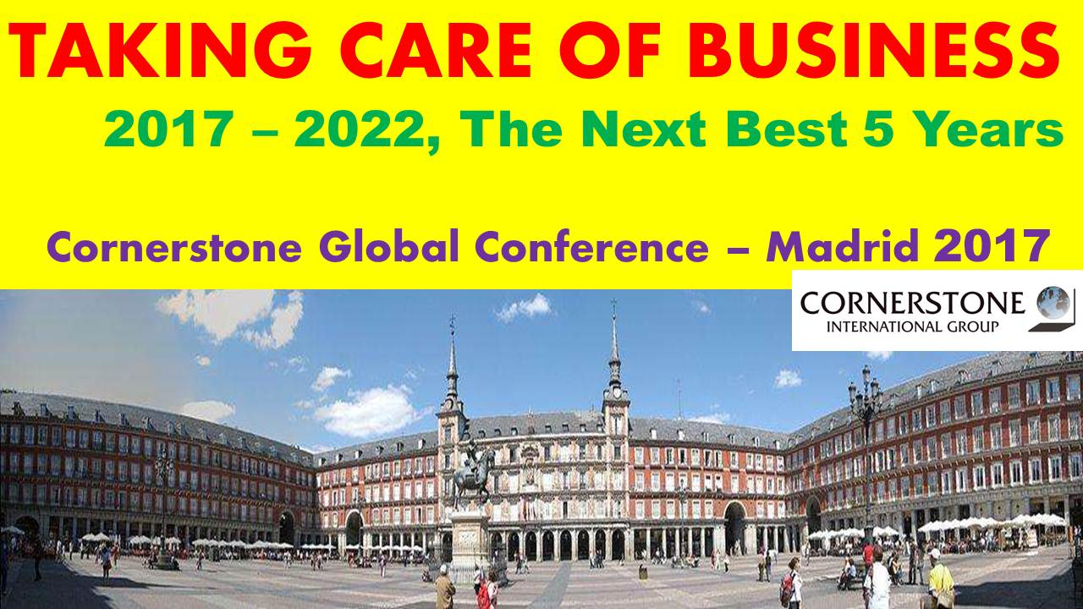
Cornerstone Executive Coaching

Slide 2
“The goal of coaching is the goal of good management:
to make the most of an organization’s valuable resources.”
Harvard Business Review

Slide 3
“Companies realize only 40-to-60 percent of their strategies’ potential value.”
Harvard Business Review

Slide 4
Successful leaders know these numbers and understand it takes much more than a great strategy to succeed.

Slide 5
You need to turn that great strategy into great performance.
That’s where strategy execution comes in.
Here is where coaching can make a difference.
It bridges the gap between brilliant strategies and superior performance.

Slide 6
Coaching advances individual performance in a business context.

Slide 7
Cornerstone Executive Coaching
Building our Qualified Team of Capable Performers

Slide 8
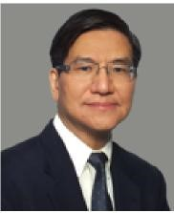
Stephen Kao
PROFESSIONAL HISTORY
32 years of corporate experience in global brands (P&G, BASF, Honeywell, Emerson, Ecolab and Danaher) helped Stephen accumulate a vast experience in leadership and management.
General Manager China,
Vice President & General Manager Asia Pacific,
Sr. Vice President & General Manager Asia
President China.
CREDENTIALS
Certified International Coach Federation.
BS Chemical Engineering University of California
Executive Development, Ross Business School University of Michigan.
Accredited in Harrison Assessment, WorkPlace Big Five, Benchmark 360 and TrueProgress 360.
FIRO-B, FIRO-Business, MBTI and DISC for personal development.

Slide 9
Stephen Kao
I strongly believe that sustainable improvements and behavioral changes start with the renewal of the mind. Coaching at the “being level” is a precondition for successful changes.
I help leaders think better so as to make better choices in order to achieve optimal outcomes and reach their goals faster.”

Slide 10
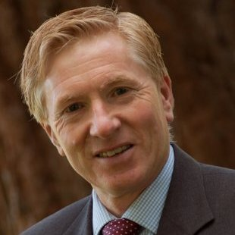
Clive Steeper
PROFESSIONAL HISTORY
30 years of experience as a business leader
Managing Director, General Manager, Operations Director
Metal Box, Goodyear, Tetra Pak, Oxford Instruments, Bridon Ropes, United Utilities
CREDENTIALS
Certified Professional Executive Coach
Certificate in Coaching Supervision
Fellowship in Manufacturing Management from Cranfield University
Chartered Engineer
Honours Degree in Bachelor of Engineering from Liverpool University.
Emotional Capital Report [ECR & ECR360] – Roche Martin,
Risk Analysis Compass – Psychological Consultancy Ltd,
Mental Toughness MTQ48 – AQR Ltd.
National Council of Psychotherapists - MNCP

Slide 11
Only Highly Qualified Executive Coaches
In the Key Markets….
irrespective of CIG office locations
Communicating the Strength of our Team to CIG
Raising the profile…..

Slide 12
Next 5 years:
2015 20 Coaches
2016 30 Coaches (Europe & China)
2017 40 Coaches (USA ) & Covering Key Markets

Slide 13
“However beautiful the strategy, you should occasionally look at the results”
Sir Winston Churchill

Slide 14



