Slide 1

Subject :

Slide 2
Assessments
Over 70% of large companies, and a growing number of smaller companies use psychometric assessments for recruiting.
Leeds Metropolitan University

Slide 3
Five reasons to use Assessments
Beats gut feel
Results are measurable
Don’t need a psych degree
Presents a positive company image
Helps shape HR strategy

Slide 4
Assessments have become an essential part of modern best practice recruiting

Slide 5
Many retained search firms are offering assessments
Korn Ferry offers 7
Spencer Stuart offers 3

Slide 6
Cornerstone Members are using many different assessments:
Harrison; Devine; Prevue; Myers Briggs; DiSC; LEA; EQI 2.0, and more

Slide 7
I am certified on 3 assessments
Cornerstone Assessment
EBW
PeopleBest/DNA

Slide 8
Each offers different benefits; used in recruiting and coaching

Slide 9
Cornerstone Assessment
5 components of an individual
Style
Values
Thinking Process
Rational Thinking
Emotional Thinking

Slide 10
EBW
Emotions and Behaviors at Work
Helps individuals and teams understand why people behave the way they do and how to maximize their engagement with, and performance at, work

Slide 11
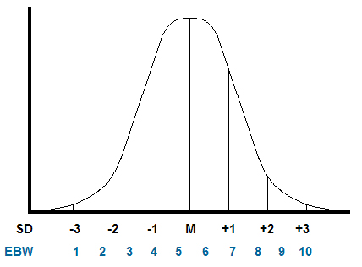
Bell Shape Curve

Slide 13
PeopleBest/DNA
Uses 29 behavior traits to arrive at these “Big 5" measures:
Originality
Channeling Effort
Extroversion
Agreeableness
Nature of Reaction

Slide 14
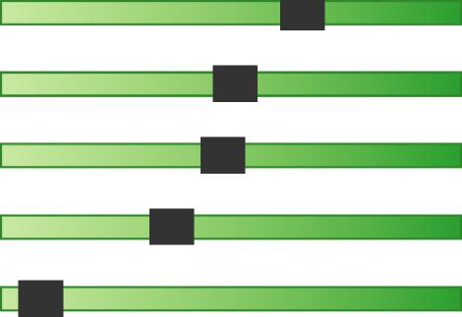
 | Christobal Lopez Robroy Conduit Division - Technical Contributor March 01, 2017
PeopleDNA“ Results
Competency
Relentless Leadership Style | 1
Mentor Leadership Style | 1
Navigator Leadership Style | 1
Autocratic Leadership Style | 1
Consensus Leadership Style | 1
Compassionate Leadership Style | 1
Trait Support Score
99 99 99 99 99
99
91
67
51
48
36
5
Page 11 of 17

Slide 15
During the upcoming breakout session I am available to share more details on these assessments and discuss other assessments you are using

Slide 17
C.

Slide 18



