Slide 1

WELCOME ADL
EXECUTIVE SEARCH with CORNERSTONE
September 1st, 2019

Slide 2







ABOUT US
CORNERSTONE
A network of 58 offices in 36 countries and the main cities of the world.
Member of AESC, Association of Executive Search and
Leadership Consultants, whose mission is to promote best
practices in the executive search industry.
Cornerstone has been rated by Forbes magazine as one of the top 10 executive search firms in the world. (Year 2016 & 2017) |  |  | CONSULTING SIGNATURE Dedicated to the attraction, search, selection and assessments of executives.
Partners in our clients’ growth with a success rate significantly over 90% |  |  | 30 YEARS OF SERVICE Topsexecutive search processes and 30 years of experience.

Slide 3

EXECUTIVE RECRUITING IS SOLUTION NOT A TASK
OUR RECRUITING looks at what you need to do, not
who you want to have.
Its focus is on Executive and Key Player Search
Its purpose is to:
Optimize the chances of success
Minimize the risk of failure
Maximize your human capital investment

Slide 4

THE MAIN DRIVERS
MOTIVATION
We believe that bringing in the best people to your leadership team is the most
important single responsibility you have to your organization.
EXECUTION
We become your partner. We help to realize your vision with the best global search,
best screening and best assessment of ability and compatibility.
CONTRIBUTION
Your investment is in bottom-line performance, so success is a point in the future.
We accelerate that arrival with onboarding and leadership development

Slide 5

OUR PEOPLE

Slide 6
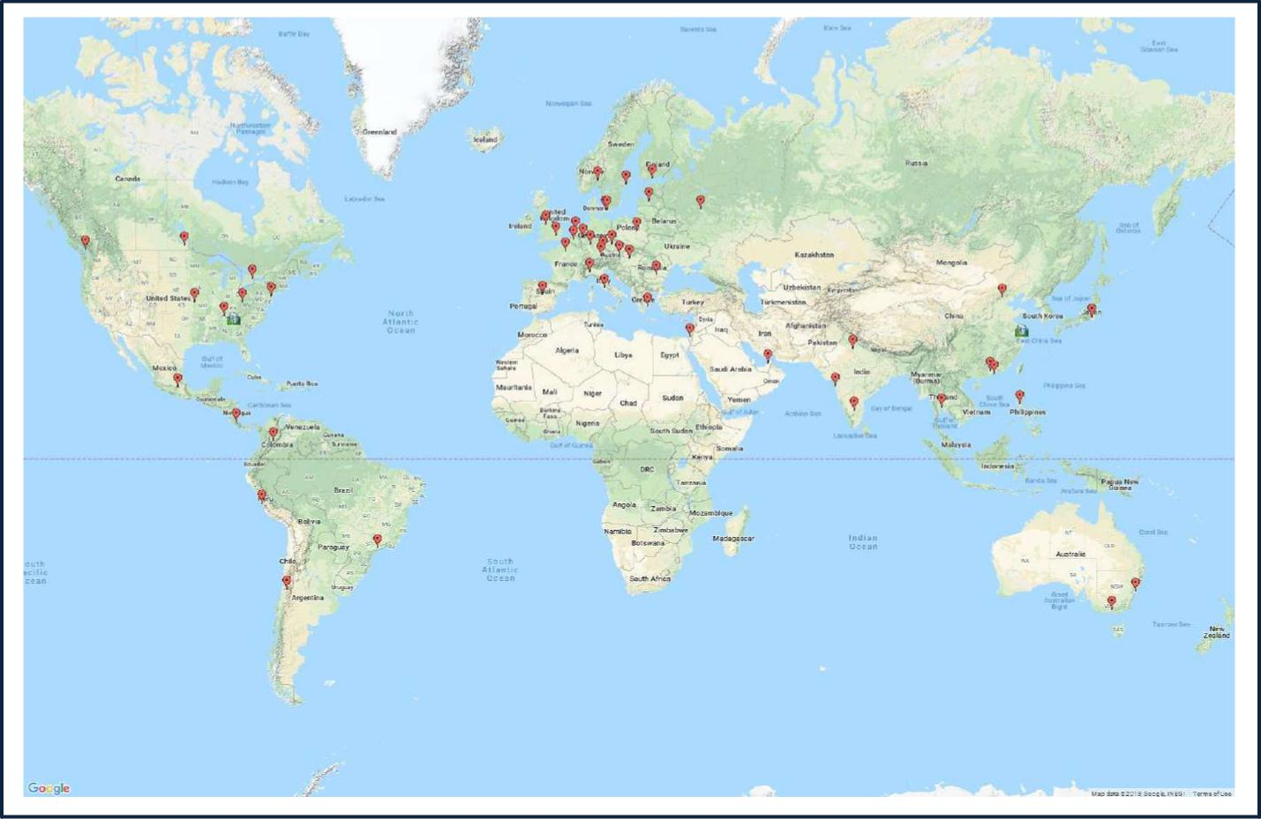
WE ARE WHERE YOU NEED US TO BE
Asia
Taipei Suzhou Shanghai Mumbai Manila KualaLumpur Hong Kong Guangzhou Delhi Beijing Bangkok LATAM
SaoPaulo Santiago Mexico Bogota CostarRca
Europe
Amsterdam Athens Berlin Brussels Bucharest
Budapest Copenhagen Dusseldorf Frankfurt Helsinki Istanbul Kiev Liverpool London
North America
Vancouver
Toronto Seattle NewYorkCity Nashville Kansas City Cleveland Atlanta
Madrid Moscow Munich Oslo Paris Prague Regensburg Riga Rome
Stockholm Tel Aviv Vienna Warsaw Zurich

Slide 7

EQUITY PARTNERS LOCALLY
Members are:
OWNERS
Webelievethat bringing in the best peopleto your leadership team isthe most im portantsingle responsibilityyou havetoyourorganization.
EXPERIENCED
We become your partner. We help to realize your vision with the best global search, best screening and best assessment of ability and compatibility.
MOTIVATED
Your investment is in bottom-line performance, so success is a point in the future.Weacceleratethatarrivalwith onboardingand leadershipdevelopment

Slide 8

EXECUTIVE SEARCH

Slide 9

SEARCH PROCESS - METHODOLOGY
UNDERSTAND EXPECTATIONSAND
JOB DESCRIPTION DEVELOPMENT
RESEARCH &
MARKETANALYSIS
INTERVIEWS &
ASSESSMENTS
SHORTLISTDELIVERY &
HIRING

Slide 10

1
.UNDERSTAND EXPECTATIONS AND JOB DESCRIPTION
DEVELOPMENT
The consultant makes a detailed report of the company and its internal organization, as
well as the environment in which it operates., including:
Comprehensive understanding of the organizational culture and leadership style of the
contracting manager.
Profile of the position
Determination of compensation package according to internal and external analysis.

Slide 11


2.
RESEARCH &
MARKET ANALYSIS
The consultant proposes and implements a strategy adapted to the needs of each
client, including:
Demonstrating the strength of our research
Comprehensive market mapping(optionalextra).
Investigating alltarget companies similar to the client organization in terms of
business, cultureand size..

Slide 12

3.
INTERVIEWS & ASSESSMENTS
Evaluationtoolsinclude:
Selection interview by competences.
Psychological evaluation of labor profile.
DISC
ICE BarOn IGF
InventoryofCompetencies
Communication styles
HarrissonAssessment(5 finalists)
Hogan(Optional)
Business case.
Labor References360°.

Slide 13

4.
SHORT LIST
DELIVERY & HIRING
Final list reports that include an interview summary, competence
assessment, business case and 360 ° work references.
Coordination of interviews with the client.
Hiring decision.
Support in the Negotiations.
Follow-up after hiring
Survey of customer and candidate satisfaction

Slide 14

PRACTICE GROUPS

Slide 15

BY INDUSTRY
Life Science Financial/ Technology Industrial Consumer Infra
Fintech structure

Slide 16

BY FUNCTION
Human Financial CEO & Operations Sales & Agil
Resources & Legal Board Marketing Talent

Slide 17

YOUR TEAM
LYDIA
GOUTAS
DAN
HEIMAN
SIMON
WAN
EUROPE
USA
CHINA
MEG
BRADT
LARRY
SHOEMAKER
USA
ALEJANDRA
ARANDA
USA
LATAM

Slide 18

LYDIA GOUTAS EUROPE (VIENNA)
European Banking and Finance Chair Cornerstone International Group & Co
Chair Financial Services Club CEE.
A native New Yorker, Lydia is a managing partner at Lehner Executive Partners
and leads an international team serving growing multi-nationals in the
European region, particularly in the Financial Services and IT sectors.
Her company focuses on executive level positions across sectors. Key to
supporting supervisory board and board decisions, Lydia also tracks trends on a
pan- European basis.
As Co-Chair / Co-Founder of the Financial Services Club CEE, a regional futurist
senior executive club, Lydia and her co-chair have been addressing the future
of banking and transformational strategies including digitization, blockchain,
and regulatory issues hindering business growth.

Slide 19


DAN HEIMAN USA (KANSAS CITY)
Dan is Chair of the North America Region for Cornerstone International Group.
He has been active in many successful engagements from Director to CEO level
assignments for several banking/financial services, manufacturing and agri-
business clients among others. He has completed international retained search
assignments in Canada, Russia, Dubai, China and South Africa.
Dan began his professional career serving the healthcare industry where he
spent 17 years in highly specialized medical technology sales, sales
management, recruiting and business development for one of the industry’s
most respected high-tech medical device manufacturers.

Slide 20


MEG BRADT USA (NEW YORK CITY)
Meg Bradt is Founder and Principal of Simetra Executive Search Partners,
CornerstoneInternationalGroup’smemberofficein NewYorkCity.
For more than a decade she has focused her executive search practice on the
corporate finance and strategic general management functions at clients
ranging from Fortune 100 corporations to private equity portfolio companies and
professional service firms.
Having lived and worked in London, Tokyo, Taipei, Hong Kong and six
American cities, she brings a global perspective to her clients. Previously, she
worked with the NewYorkoffice of Boyden, a global executive search firm.

Slide 21


LARRY SHOEMAKER USA
(ATLANTA) Larry is President of Cornerstone International Group.
Since founding Shoemaker & Associates in 1990, Larry has been conducting
senior-level recruiting assignments, executive coaching and leadership
assessments throughout North America, as well as globally.
His focus is on the candidate’s fit into an organization’s culture.
Larry’s experience as an executive coach and assessment trainer gives him a
unique perspective to a search. His professional experience includes more than
20 years in general management, sales and marketing management, strategic
business development and M&A.
He has been a key contributor within organizations ranging from Fortune 200,
middle market, U.S.

Slide 22


SIMON WAN
ASIA-PACIFIC
(SHANGAI, CHINA)
Simon is the Chief Executive of Cornerstone International Group worldwide
and also the President of Cornerstone in Chin. He is based in the Shanghai
office.
Most of Simon’s clients are senior level executives and business owners who
want to get world class support & advice on talent acquisitions and HR issues.
He has particular interest in working with HR executives & business owners
who want to improve their organization competencies and passionately want
to leave a legacy of their time in office.
Prior to joining Cornerstone China as President in 2003, Simon was with Philips
Lighting as General Manager of China / East Asia and was previously General
Manager of Carnation Foods, Getz Brothers trading and in government services
in Canada as Trade Director for China & South Pacific.
Simon is a native of Hong Kong and studied and worked in Canada. He has
been a resident of Shanghai since 1993.

Slide 23
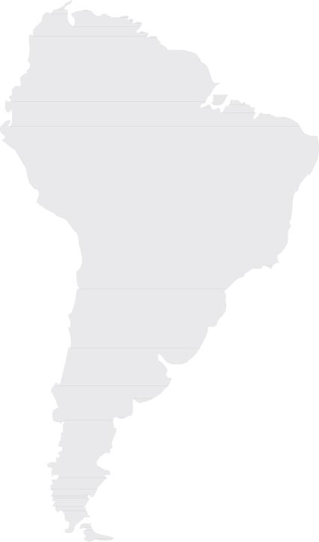

GONZALO DOOR
Gonzalo is Managing Director & Partner of Cornerstone Mexico in Mexico City
and widely connected throughout Central and South America.
He has over 30 years of top management responsibilities as General Manager
and Commercial, Sales and Talent Development Manager with leading
multinational Consumer Goods Corporations as well as entrepreneurship
experience with Director & Partner roles in Talent Management, and Executive
Search.
LATINAMERICA
(MEXICO CITY)
Gonzalo has filled executive positions in Mexico, Peru, and Central America and
has direct experience in 19 Latin American countries.
Gonzalo has deep expertise in talent development. He has knowledge of more
than 25 business categories as well as coaching and leadership of large teams.
He is recognized for delivering outstanding business results and developing
people.

Slide 24


ALEJANDRA ARANDA
LATINAMERICA
(SANTIAGO, CHILE)
Alejandra is Chairman of Cornerstone International Group’s LATAM Region. She
is also Founding partner and President of HUMANITAS, Global Executive
Search, Cornerstone’s member firm in Santiago, Chile.
She is a Board Member, President of the Nominating Committee and former
Chair of the Human Capital Committee in AmCham Chile (American Chamber
of Commerce); Counselor for the Americas of AESC (Association of Executive
Search and Leadership Consultants); member of the Chilean Chapter of WCD
(Women Corporate Directors) and Counselor of Comunidad Mujer.
Since 1994, she has been dedicated to the search for C-levels executives and
Board members, having worked in Latin America, Europe and North America.
She was named a “Leading Consultant” by The Economist Intelligence Unit and
recognized several times as one of the 100 women leaders in Chile by the
influential newspaper El Mercurio.

Slide 25

PRICING
Fee Basis - 28% of base salary First stage: € 20k Second stage: €20k
Completion: balance due
Considerations
Cancellations
-In the event of cancellation before delivery of the short list, the first stage invoice will be payable
-In the event of cancellation after delivery of the short list, the 80% of our total invoice will be payable
-In the event of cancellation after presentation of the candidate, the total invoice will be payable
Referral
-If the chosen candidate is referred by the client and completes the selection process, 80% of the original total search fee will be invoiced.
Interruption
-In the event that the client decides to suspend the search temporarily, Cornerstone will wait 3 months to restart the process. Reactivation after this period, will be treated as a new mandate

Slide 26
CONTACTO
LYDIA GOUTAS
MANAGING PARTNER - Cornerstone Vienna
(Lehner Executive Partners) l.goutas@lehnerexecutive.com
+436646118207
www.cornerstone-group.com

Slide 27

WELCOME ADL
WEB www.cornerstone-group.com

