Slide 1

Practice Groups: Life Sciences & Healthcare
Dominic Yim
Geraldine du Tilly

Slide 2

Welcome To LSHC (Life sciences & Healthcare)
Purpose of the practice
How to add value
The Team
Practice/sectors in Life Sciences & Healthcare
Challenges and Issues
Key Global players for Pharma
Some interesting facts
Our foot print
Keys to success in LSHC candidates
Going forward

Slide 3

Purpose of the Practice
We leverage industry and country knowledge from different geographies and experiences
We leverage clients with regional and International needs
We will better meet our client’s requirements as advisors in a complex industry that is transforming quickly around the globe
We help clients to find difficult roles and game changers for business transformation.
We embark on Global Marketing
We embark on Global Branding
We are ONE team and ONE goal
We develop more business as a team rather than working on selected assignments as independent consultants.

Slide 4

How to add-value
Marketing materials for client prospects: White papers, presentations, etc. Many of these materials are already on the website.
Separate Portal
Joint development of clients globally
Monthly conference calls
Sharing of assignments
Practice Leads
Knowledge sharing , training of new consultants etc.

Slide 5
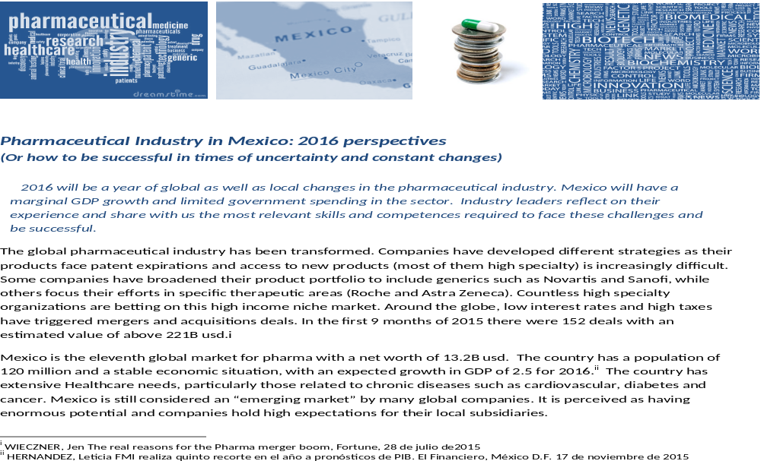

Slide 6

The Team
Geraldine and I are trying to put together a global team for Cornerstone Life Sciences and Healthcare practice with passionate members across the Americas, Europe and Asia Pacific.
The Aim is to create more business opportunities

Slide 7
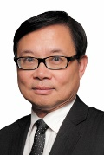
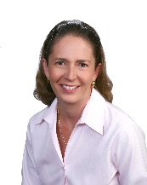
Core Leadership Team
Dominic Yim – Co Lead
Managing Partner of Cornerstone China based in Hong Kong and Shanghai
Held senior operational positions with Philips Medical, Medtronic AP, Steris Corporation, Siemens Healthcare, St. Jude Medical and Biosensors.
Executive Director with Russell Reynolds Associates in Hong Kong and with Asia Executive Talent
Over the past 15 years, has recruited many C level executives for Fortune 500 healthcare and life sciences companies
Geraldine Du Tilly - Co Lead
Managing Director of Cornerstone Mexico City.
12 years with Russell Reynolds Associates in Mexico City as Executive Director.
Extensive expertise in the human resources and financial functions across industries and has also developed broad experience in the healthcare, technology and consumer industries.
With Russell Reynolds, led the Healthcare sector in Latam and was also Latam Relationship Manager for a major consumer account.

Slide 8

Practice/Sectors in Life Sciences Healthcare
Pharmaceutical
Medical devices
Diagnostic and therapeutic equipment
Bio-research sciences
Bio-chemical
Healthcare deliveries
Consumer healthcare
Healthcare IT and
Healthcare consulting

Slide 9

Challenges and issues
Global industrial-wide slow down
Regulated pricing and cost control are norms
Underlining political influence in the healthcare business
New global and emerging markets – China, India, Vietnam, South America, Eastern Europe and Africa
Integration of life sciences, healthcare delivery and consumerization of products and services to home medicine
Technology is driving innovation- new drugs, new devices, applications
New partnerships and collaboration (JV’s, M&A)
Industry with the greatest potential for growth in the next 50 years

Slide 10













Key Global Players for pharma

Slide 11


Some interesting facts…
‘s Cialis®, is expected to slide to just $55 million in 2022 sales from a hefty $1.42 billion in 2016 (patent loss)
For Opdivo®, an inmuno oncology drug, sales grew from $942k in 2015 to 3.774 billion usd. in 2016
Rheumatoid arthritis med Humira® has $16 billion in sales, more than 60% of ‘s total sales.
Analysts say BMS could be a takeover target for Roche, Novartis or Pfizer
agreed to pay $519 million to settle U.S. charges that it violated U.S. foreign-bribery law in its operations in Ukraine, Mexico and Russia.

Slide 12






Our footprint
We have experience in highly specialized positions:
Country Manager (China)
President of Japan
CEO
Regional Clinical Manager
HRD East Asia
VP of Quality Assurance and Regulatory- Asia and Latam
Regional Human Resources Director- LATAM
Vice President - R&D
VP - Quality
Chief Technology Officer
Regional Business Development Director LATAM
Operations positions: Site Leader- Quality leader- EHS- Pharmaceutical Dev. Mgr.

Slide 13
Keys to success for LSHC candidates:
Highly technical professionals often PhD in Clinical Studies
Understanding the healthcare regulated environment
Relationships with public and private healthcare sector
Strong understanding of the healthcare insurance industry
Understanding of the complex schemes for delivery of goods and services within the life sciences and healthcare industry

Slide 14

Going forward
Monthly conference calls
LSHC Cornerstone website
Special Sessions at the Global / Regional Meetings
Clients Focus events and activities
Strategies and Action Plans
Etc.

Slide 15


