Slide 1
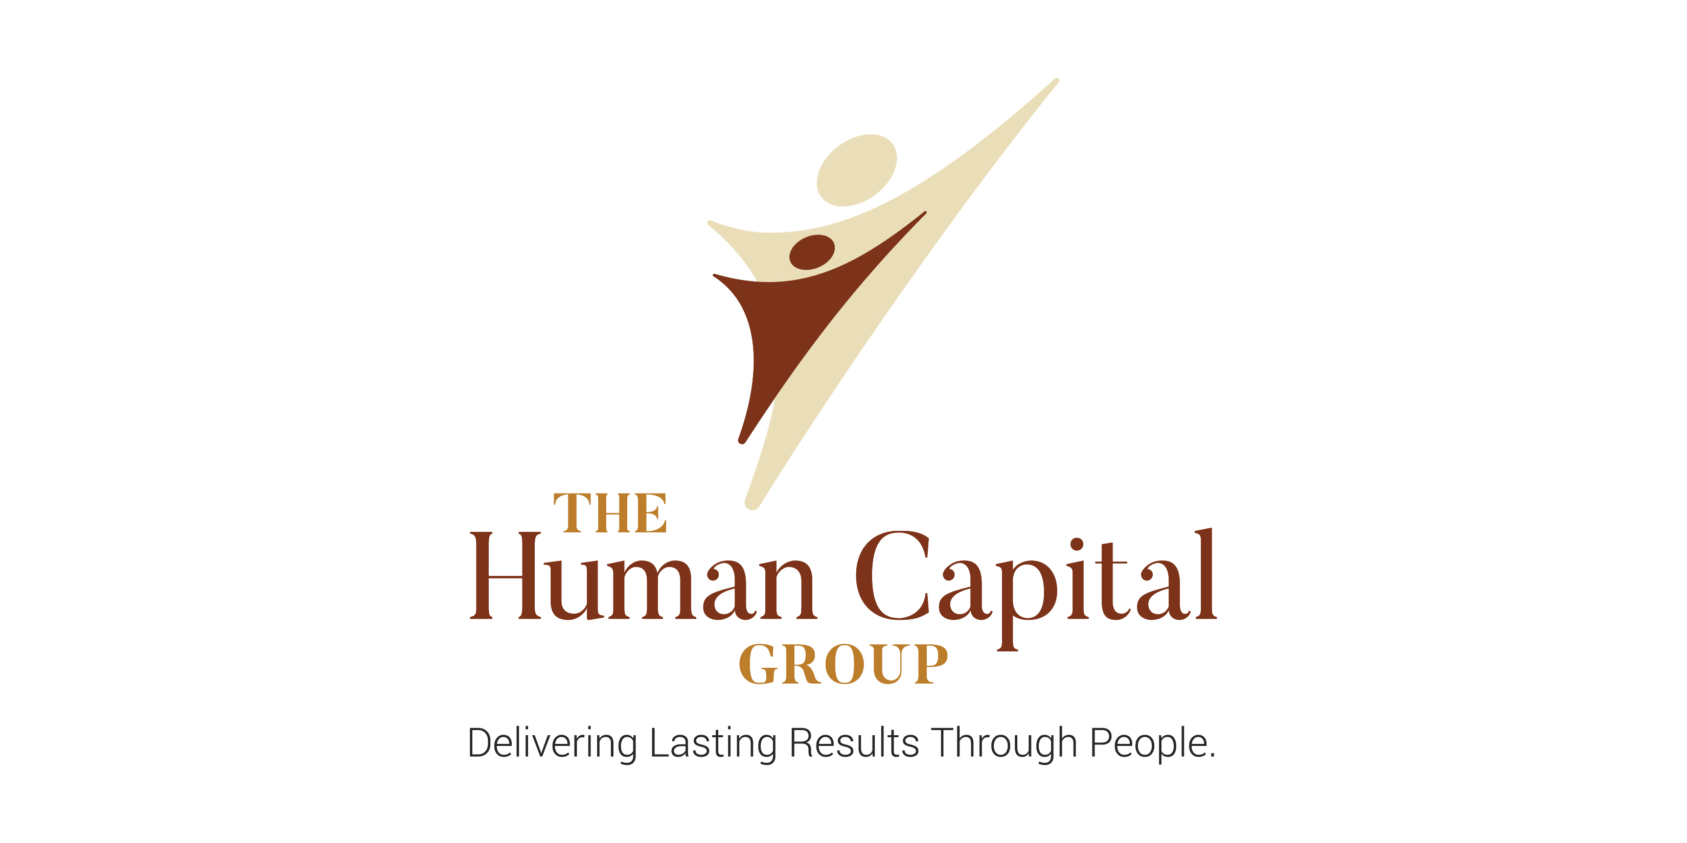
Brand Expansion
Becoming a Leadership Advisory Firm

Slide 2

Where Do We Start?
This Photo by Unknown Author is licensed under CC BY-NC

Slide 3
The Human Capital Group Current State
Executive Search
  85% revenue
  8 staff support
Leadership Consulting
  15% revenue
  1 staff support

Slide 4
Brand Expansion:
Align internal culture and talent
to business
strategy
Develop a focused and integrative brand to leadership advisory
Assess current state to build
future state
Notes:
Read slide. Holistic, they are interconnected.

Slide 5
Brand Expansion
We started with Defined Outcomes:
Assess current needs/state and identify most critical issues that need to be addressed
Define future state
Provide a gap analysis
Build out a Strategic Plan around needs and identify ways our solution can be most effective in supporting our clients. Gain alignment.
Design a plan encompassing goals and processes that are measurable and reportable to ensure the tracking of successful work efforts
Work with internal and external key stakeholders to collaboratively design the transition plan from current to future state.
Guide implementation by enabling impact. Support plan, process and team as needed before, during and after expansion

Slide 6
Research
Cornerstone
AESC
The Conference Board
Developmental Dimensions International (DDI)
Centers for Creative Leadership (CCL)
Harvard Business Review
Peers
Competitors

Slide 7
Interviews
Competitors
Peers
Current Clients
Potential Clients

Slide 8
AESC Report Forecast
How will our profession evolve?
Services that will compromise the greatest revenue in the profession in 10 years
Executive Search
Leadership Assessment
Board Search
Board Effectiveness Consulting
Talent Mapping
Talent “Big Data” Analytics
Culture Shaping

Slide 9
Cornerstone International
Onboarding: The drop-off rate among newly hired executives is staggeringly high. Research indicates that 40% of new senior executives fail within the initial 18 months.
Internal Coaching Programs: Many forward-looking global companies are leveraging the power of coaching by training their key executives, managers and leaders in professional coaching skills.

Slide 10
What did we find out?
Clients would like an integrated talent solution provider
Their pain points are the attraction, development and retention of talent
Talent solutions need to be tied to the overall organizational strategy and show an ROI
The negative connotation of coaching has changed: Xers want access to external coaching
Development is personalized and performance discussions are ongoing

Slide 11
What did we find out?
Leadership behaviors need to be congruent with stated culture
High potentials want external coaching that supports a tailored development plan
Diagnostically based solutions
High quality leaders impact the bottom line
Integration of talent is key. Misalignment needs to be addressed right away
Predictive analytics need to be strong. People analytics need to show impact, trends, success

Slide 12

The Human Capital Group Growth
Expansion of brand with clarity and focus

Slide 13

At The Human Capital Group we partner with our clients to help them ..
Find
Grow
Their Leadership Talent and Teams
Strengthen

Slide 14
At The Human Capital Group we partner with clients to ..
Leadership Advisors
Find
Strengthen
Grow
Leaders
Leaders & Teams
Leaders, Teams & Organizations
Alignment
Delivering Lasting Results through people

Slide 15
The Human Capital Group Future State
Talent Advisory
Executive Search
  Re-brand & Add services
    Generalist with industry expertise
      Industrial
      Private Equity & Technology
      Consumer Goods
      Healthcare
      Education & Non Profit
  Top 5 functions served: C-Suite, Operations, HR, Sales & marketing, Finance
Leadership Consulting
  Focus on Strengthen and Grow
  Design programs/process for consistency
  Add adjunct support

Slide 16
Review:
Steps taken to get there
Why
What
How
When
Research
Interviews & Leveraging Relationships
Leadership Strategic Planning
Vision, Mission and Values Alignment
“Serve One Another Through Love”
Branding of new program offerings
Additional resources
Website redesign
Marketing Plan
Social Media Plan

Slide 17

“Our real problem, then, is not our strength today; it is rather the vital necessity of action today to ensure our strength tomorrow.” ~ Dwight D. Eisenhower

Slide 18


This Photo by Unknown Author is licensed under CC BY

Slide 19

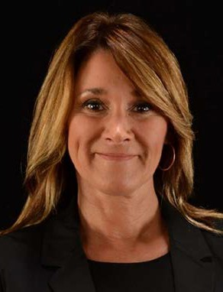
GINGER DUNCAN, Senior Consultant and Executive Coach, specializes in the integration of leaders and teams to gain competitive advantage and deliver sustainable business results. With over 20 years’ experience in leadership development, coaching, facilitation and training, plus 11 years leading the talent development function in a corporate setting, Ginger has extensive experience partnering throughout organizations to guide strategic business alignment. Her work in leadership consulting consists of partnering with ExxonMobil, Anderson Healthcare, California Paper Company, Portola Packaging, Transamerica, Ingram Barge, Hunt Brothers Pizza, Retrieving Independence, Healing Hands International and Hopkinsville, KY, Board of Education. Ginger’s values-based approach to coaching equips her with sound, practical and timely expertise rooted in the servant-leadership model. As an approachable yet direct partner, Ginger guides and coaches while helping her clients translate their business goals and executable plans to align with the needs of the business.
Ginger received two undergraduate degrees from the University of Massachusetts Boston and two graduate degrees from Murray State University in Kentucky. She is also a certified Master Coach from the Behavioral Coaching Institute.
www.HumanCapitalGroup.com
Ginger@HumanCapitalGroup.com

