Slide 1









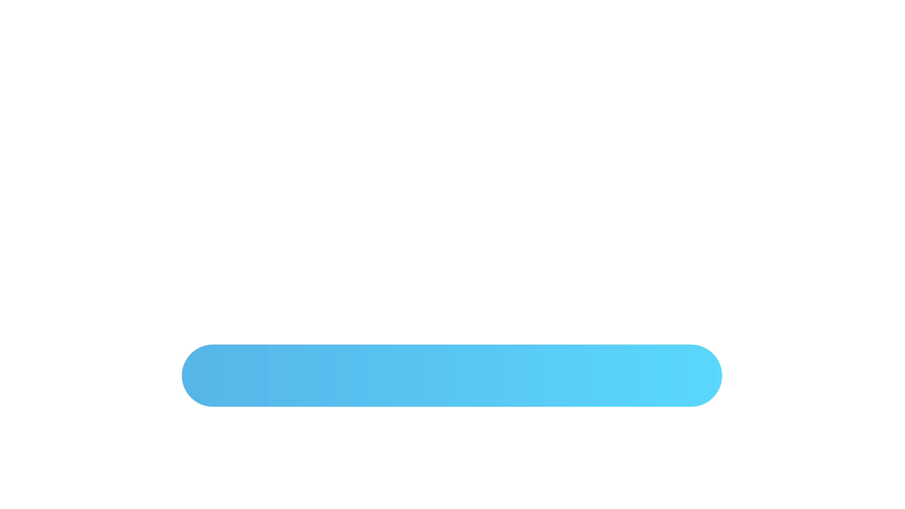
EXECUTIVE SEARCH NEAR OR FAR
ACHIEVE MORE WITH CORNERSTONE.
40 COUNTRIES & 60 OFFICES SINCE 1989

Slide 2


SEARCH IN 2022
We know Executive Search is global in scope. Now the process is changing. Technology and AI join with Skill and Experience in new, hybrid solutions.
Search changed. So did Cornerstone.

Slide 3

HOW WE SEE SEARCH
Still, some things don’t change.
Executive Search is not filling a position. It is finding the special person who will help deliver your vision.
We do so in 5 Stages.

Slide 4

Relationships
1
Cornerstone achieves more as we serve as your Trusted Partner.

Slide 5
WHY YOU NEED A PARTNER
What We Need
What You Need
What We Get
A professional search consultant must get to know your business and your culture in detail
A consultant who understands exactly what drives your organization and where you want it to go
The right firm will bring knowledge of both your industry sector and where to find suitable candidates

Slide 6
CORNERSTONE IS YOUR TRUSTED PARTNER
We’re Global
Experienced
Accepted
We have 60 offices in 40 countries and can offer you a single point of access
We have over 30 years of service excellence recognized by Forbes Media and Hunt Scanlon
Our superb quality level is acknowledged worldwide by AESC- the Association of Executive Search and Leadership Consultants

Slide 7
WHAT CORNERSTONE BRINGS
Motivation
Execution
Contribution
We believe that bringing in the best people to your leadership team is the most important responsibility you have to your organization.
We help you to realize your vision with the best global search, best screening and best assessment of ability and compatibility.
Your investment is in bottom-line performance, so success is a point in the future. We accelerate to that with leadership development

Slide 8

2
Our Process
A global pandemic has killed face-to-face. Phase One research is now on-line and data analytics are supplementing the candidate database

Slide 9



Our Phase One research is mostly online.
Virtual interviews are faster, waste less time, and deliver the world without costly travel
1
SPEED & SCOPE
2
Online reporting as needed means you spend less time on hiring
3

Slide 10



You get two lists of candidates
1
The first contains all the persons we consider qualified and a good fit.
2
MAXIMIZING YOUR TIME
3
The second has your input, follows rigorous verification and becomes a list of your finalists

Slide 11



LAND & EXPAND
1
We are your key to new markets. We are on the ground in 40 countries.
2
We deliver regional market knowledge around the world
3
Your search can be managed locally and with single-point access

Slide 12
OUR SEARCH PROCESS
2
4
6
We map relevant markets, find and evaluate exceptional candidates
We rigorously investigate and assess final candidates
We manage custom onboarding as required (recommended)
1
3
5
We discuss what you want to achieve and who we need to find
We review a short list with you
We assist in engaging a winner if required

Slide 13

3
Our Edge
Cornerstone is differentiated by its structure and its values

Slide 14

THE REACH OF MANY
Cornerstone members are unique in their territory. They are industry experts who serves as a two-way bridge between emerging and advanced markets around the world

Slide 15

THE FOCUS OF ONE
Cornerstone consultants share experience and a commitment to excellence that creates one global, unified opportunity to our clients.

Slide 16

SHARED VALUES
Our members are dedicated to Diversity & Inclusion in all our dealings
We are members of the AESC, the standard of excellence in search
Our coaches are all members of the ICF, the largest coaching federation

Slide 17

4
Specializations
Your Executive Search professional partner should have relevant geographic, sector and functional experience

Slide 18
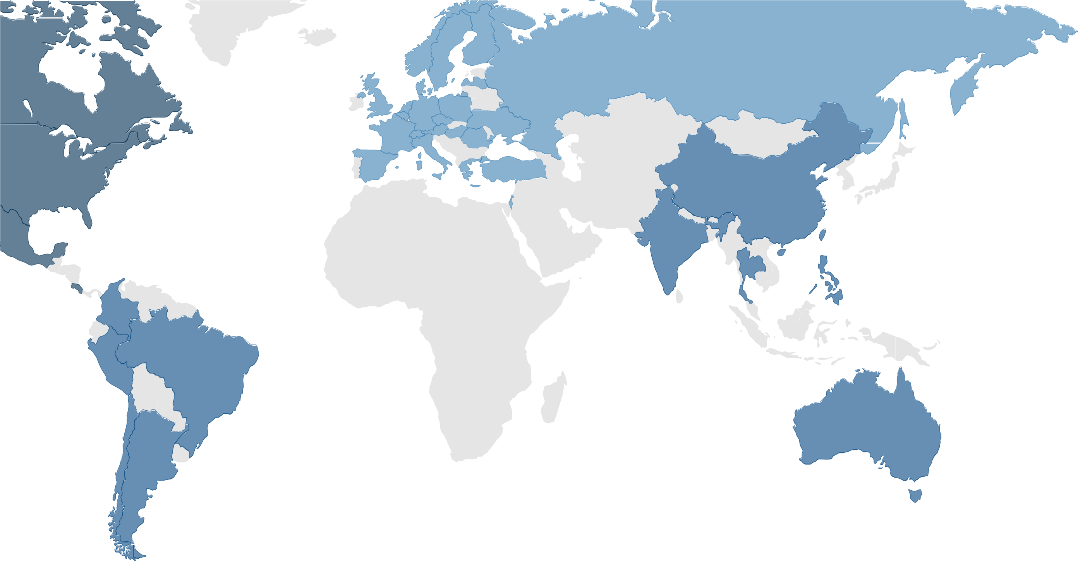
GEOGRAPHY
Over 225 specialists established in 40 countries
Over 100 accredited ICF Coaches in 20 countries.
Austria
Belgium
Czech Republic
Netherlands
Denmark
England
Finland
France
Germany
Greece
Hungary
Israel
Italy
Netherlands
Norway
Poland
Romania
Russia
Saudi Arabia
Spain
Sweden
Switzerland
Turkey
UAE
Ukraine
China
Australia
India
Japan
Philippines
Singapore
Taiwan
Thailand
Argentina
Brazil
Chile
Colombia
Peru
USA
Canada
Costa Rica
Mexico

Slide 19

INDUSTRY
INDUSTRIAL
Financial & Fintech
Consumer
Life Science
Non-Profit

Slide 20

FUNCTION
CEO & C-Level
Board of Directors
Finance & Legal
Senior HR
Agile Talent

Slide 21

5
Case Histories

Slide 22
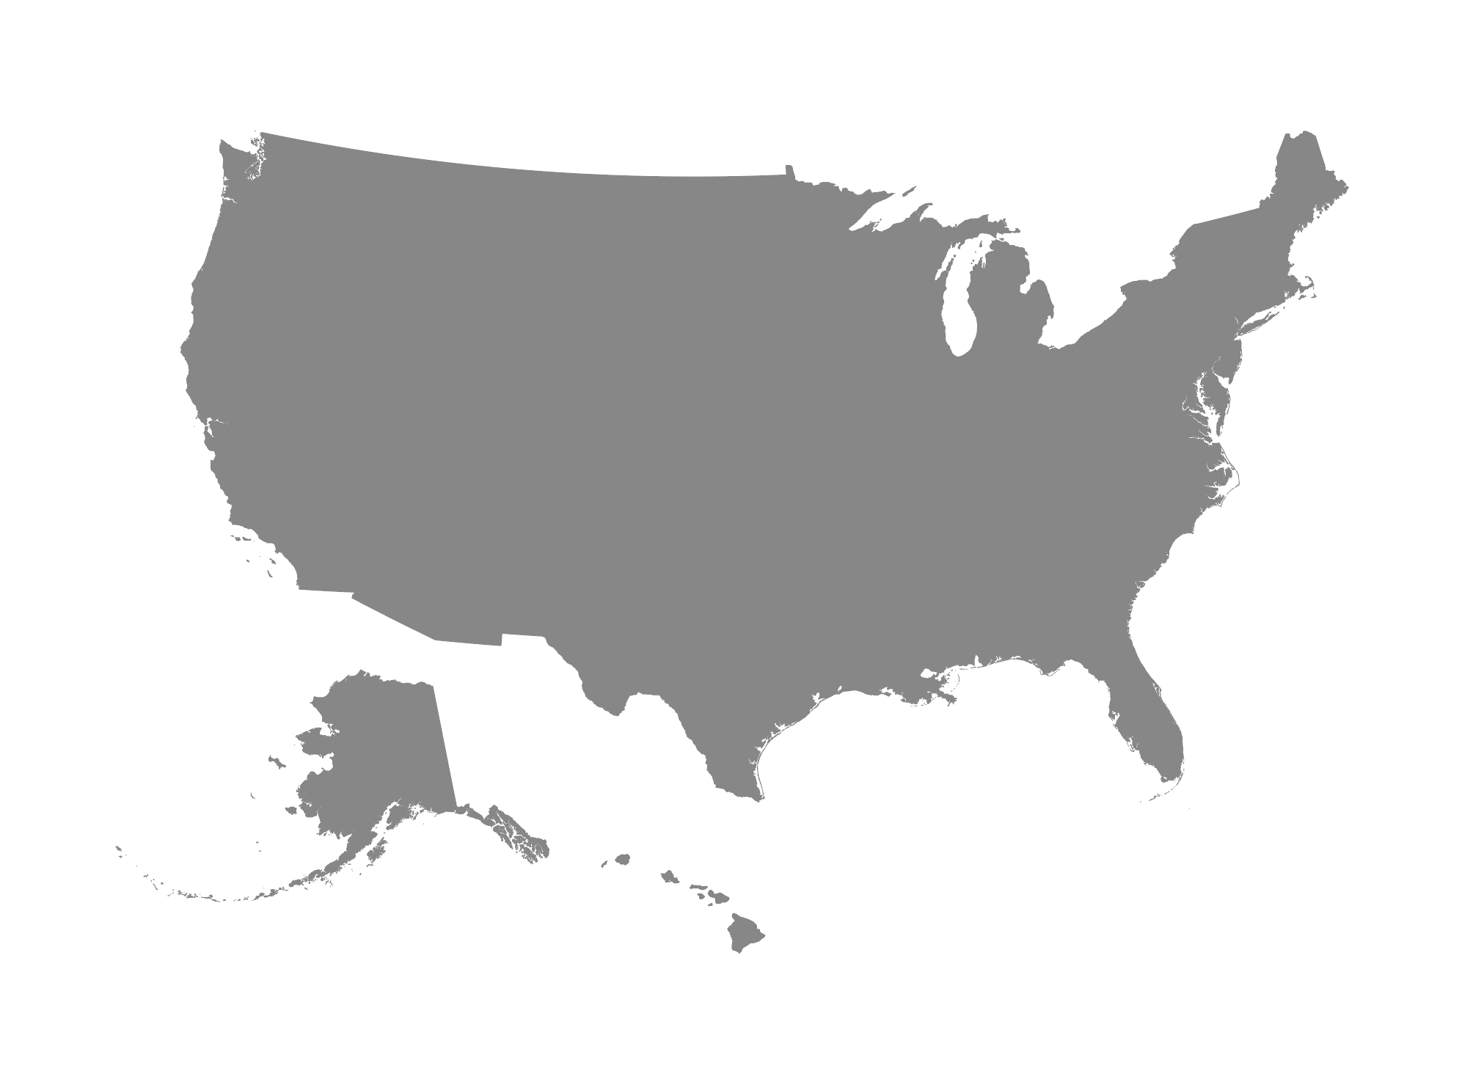
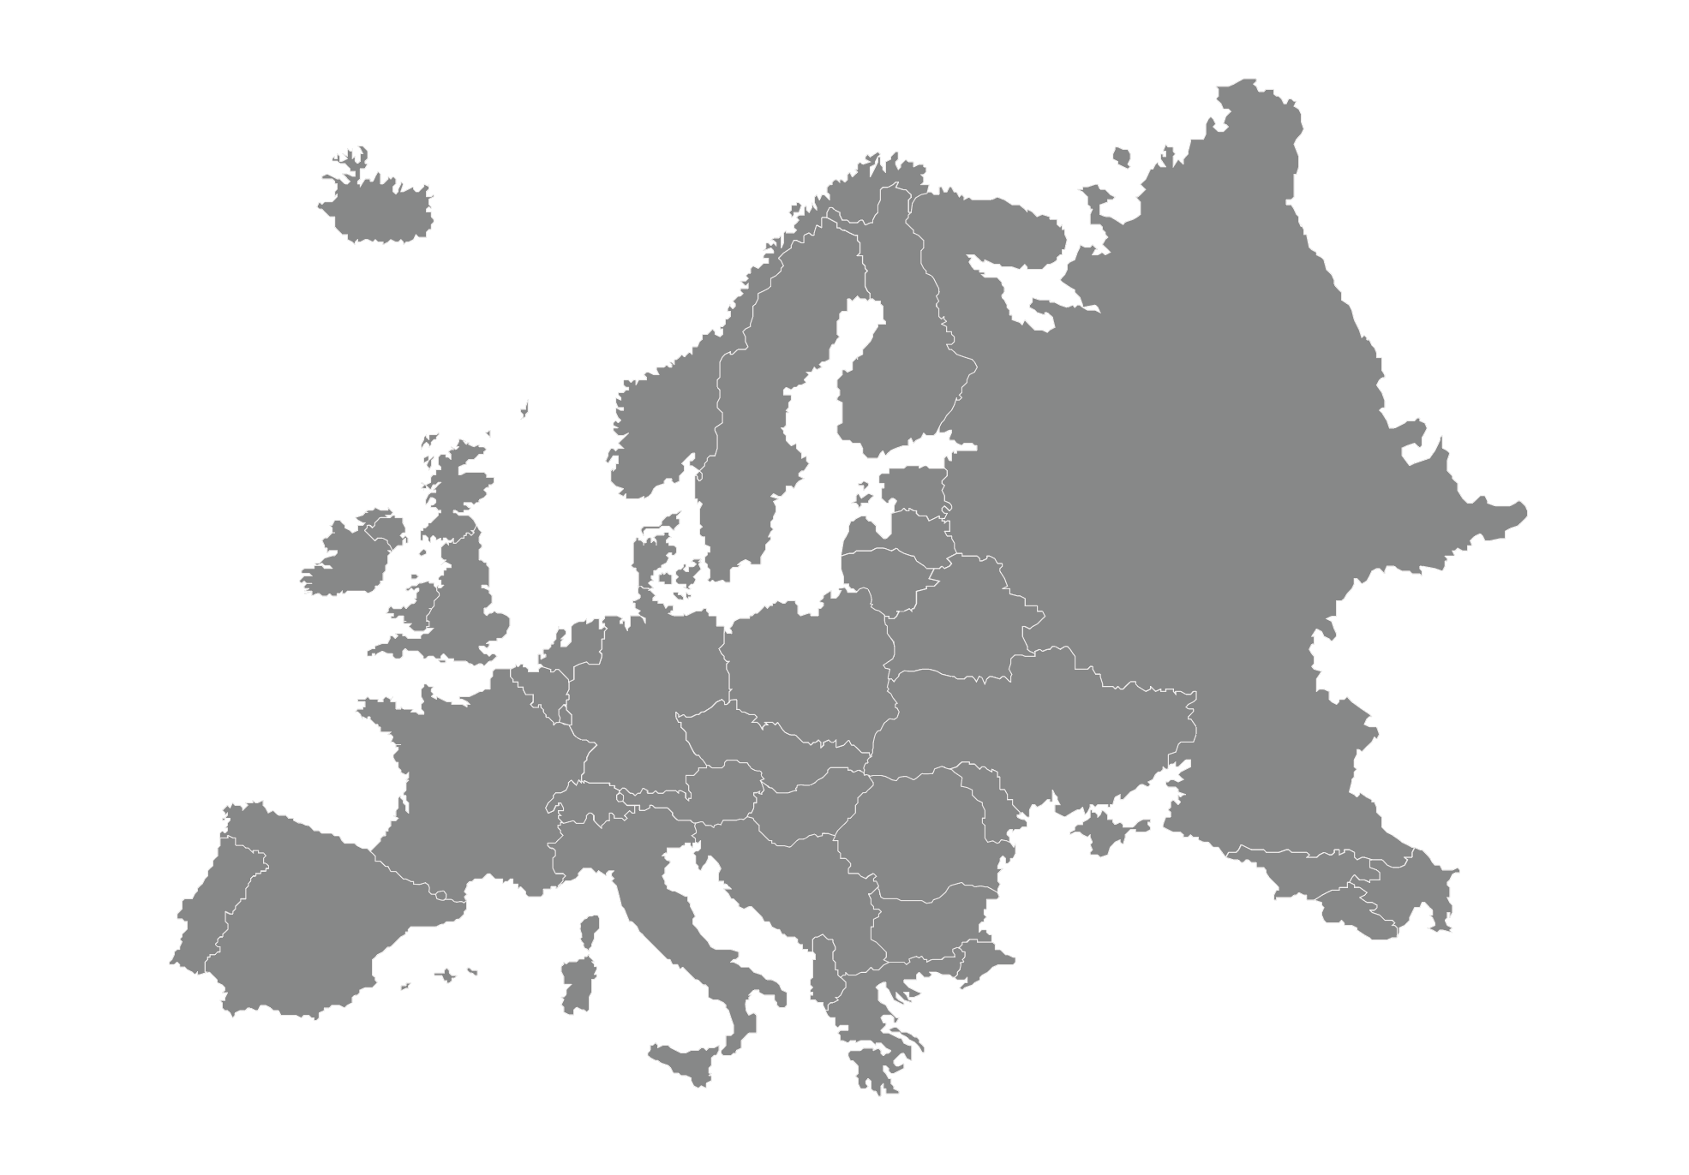
UNITED STATES TO EUROPE
WHO
WHAT
HOW
Leading producer of wet wipe products. Orangeburg, NY
MD International for UK and Euro business
Full market search produced strong bench from leading businesses in multiple countries

Slide 23


LONDON TO WARSAW
WHO
WHAT
HOW
UK’s leading producer of filled bedding products (pillows etc)
Two executives for Polish subsidiary
Positions filled by Cornerstone Warsaw and Cornerstone Dusseldorf. Search managed by Cornerstone London

Slide 24
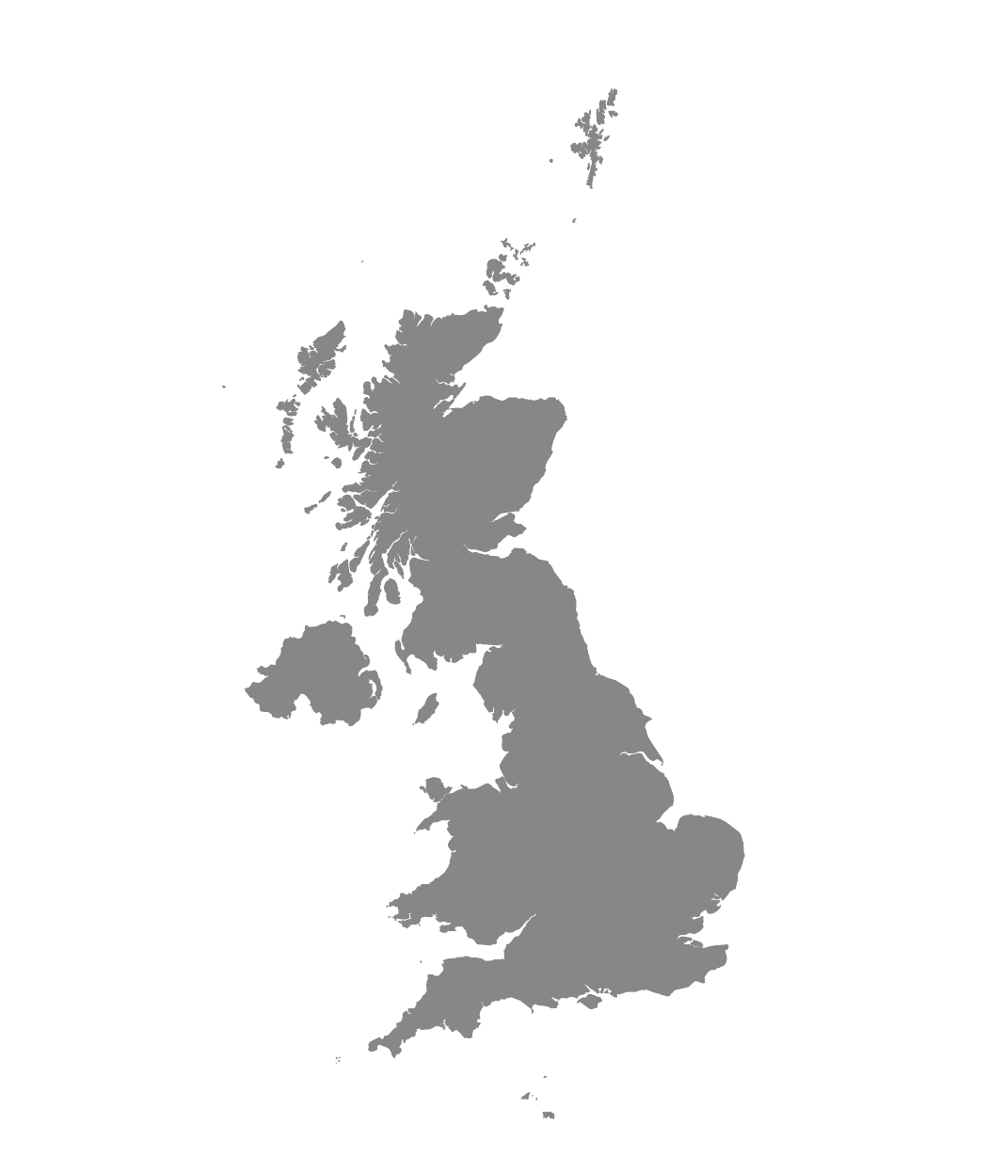
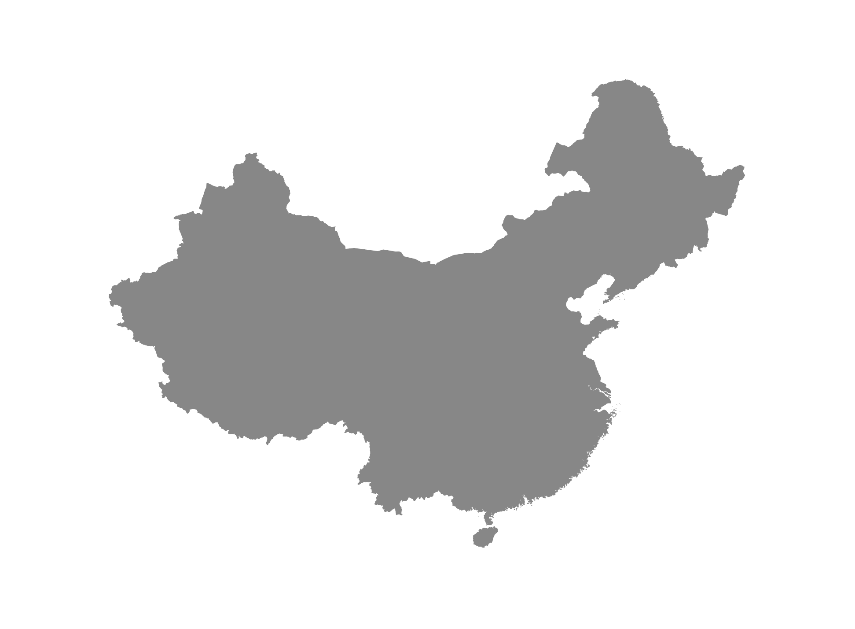
UK TO CHINA
WHO
WHAT
HOW
Leading paper products producer listed on LSE
Executive team of three to lead overseas expansion into China
Positions filled after search across Asia-Pac region managed by Cornerstone Hong Kong and Cornerstone Guangzhou

Slide 25

Simon Wan, Chairman & CEO (SHANGHAI)
simon-wan@cornerstone-group.com
Larry Shoemaker, President (ATLANTA)
larry-shoemaker@cornerstone-group.com
Laurie O’Donnell, Executive Coaching
laurie-odonnell@cornerstone-group.com
Nance Macleod, Career Management & Brain Trust
nance-macleod@cornerstone-group.com
Goran Jansson, EMEA
goran-jansson@cornerstone-group.com
Dan Heiman, North America
dan-heiman@cornerstone-group.com
Edwin Yeo, Asia-Pacific
edwin-yeo@cornerstone-group.com
Diego Cubas, Latin America
diego-cubas@cornerstone-group.com
OUR GLOBAL BOARD

