Slide 1

It’s Time
You Met
CORNERSTONE

Slide 2
Each
YEAR…
… WE MEET MORE PEOPLE
Which is as it should be after 29 years
And something we love to do
So a Big Welcome to
Cornerstone International Group!

Slide 3
Let’s start here….
Cornerstone International Group, with 56 offices in 34 countries (and growing), is a global network of search and leadership development specialists who own their firms, lead in their markets, have strong records of service and performance and are committed to delivering the best person for every job.
We call that Best Recruiting.

Slide 4
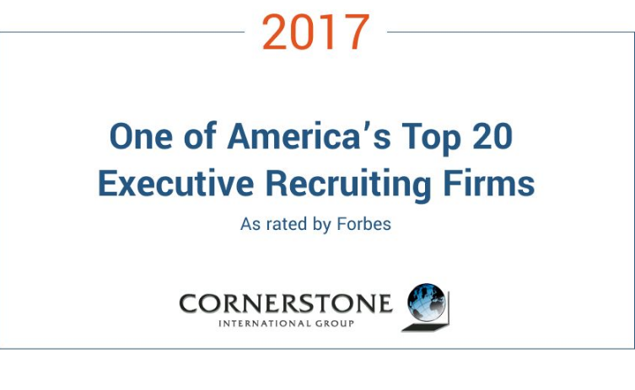
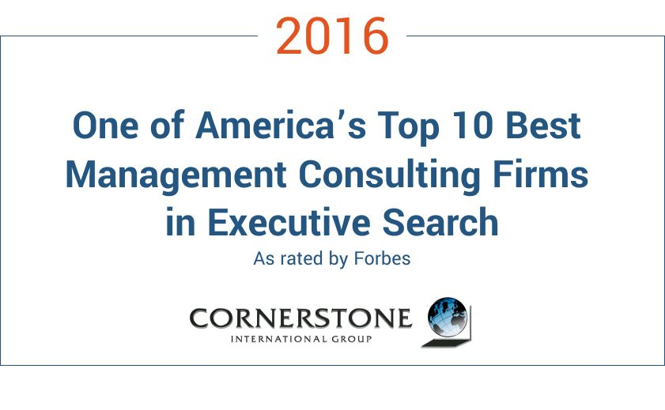
So do others…

Slide 5
What Is
Best Recruiting?

Slide 6
BEST
RECRUITING
IS A
SOLUTION
NOT A
TASK
Best Recruiting looks at what you need to do, not who you want to have.
Its focus is on Executive (and KeyMan) Search
Its purpose is to:
  optimize the chances of success
  minimize the risk of failure
  maximize your human capital investment

Slide 7
The main drivers
Motivation
We believe that bringing in the best people to your leadership team is the most important single responsibility you have to your organization.
Execution
We become your partner. We help to realize your vision with the best global search, best screening and best assessment of ability and compatability.
Contribution
Your investment is in bottom-line performance, so success is a point in the future. We accelerate that arrival with onboarding and leadership development

Slide 8

Time to peek
Behind
The
curtain……

Slide 9
Our
People

Slide 10
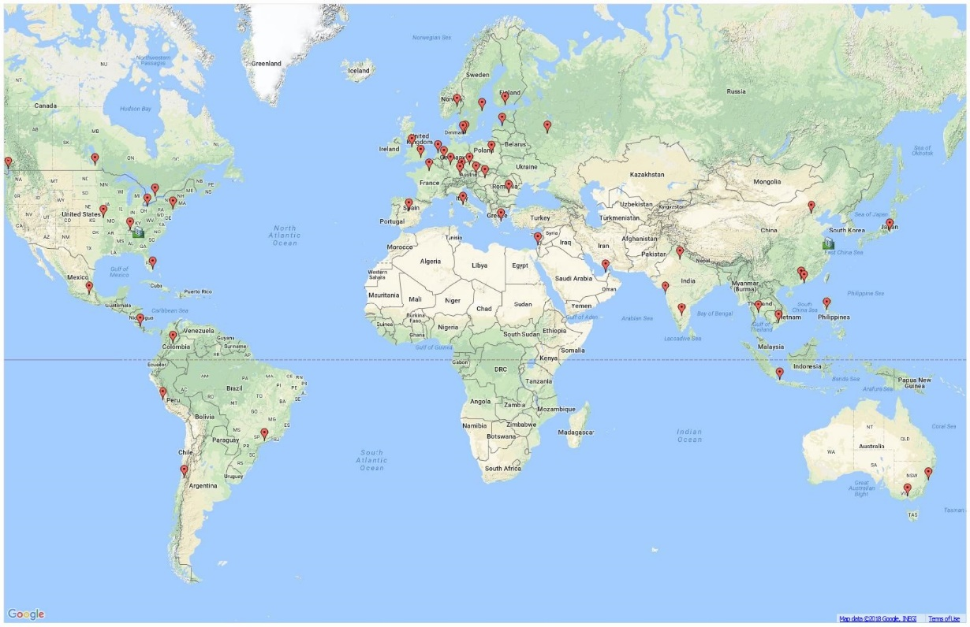
Globally PRESENT
29
YEARS
56
OFFICES
34
COUNTRIES
2
HEAD OFFICES

Slide 11
Globally Connected
Amsterdam | Manila
Athens | Melbourne
Atlanta | Miami
Bangalore | Mexico City
Bangkok | Moscow
Beijing | Mumbai
Bogota | Munich
Bucharest | Nashville
Budapest | New York City
Cleveland | Oslo
Copenhagen | Paris
Costa Rica | Prague
Delhi | Regensburg
Dubai | Riga
Dusseldorf | Rome
Frankfurt | Santiago
Guangzhou | Sao Paulo
Hanoi | Shanghai
Helsinki | Stockholm
Ho Chi Minh City | Sydney
Hong Kong | Taipei
Jakarta | Tel Aviv
Kansas City | Tokyo
Lima | Toronto
Liverpool | Vancouver
London | Vienna
Lund | Warsaw
Madrid | Winnipeg

Slide 12
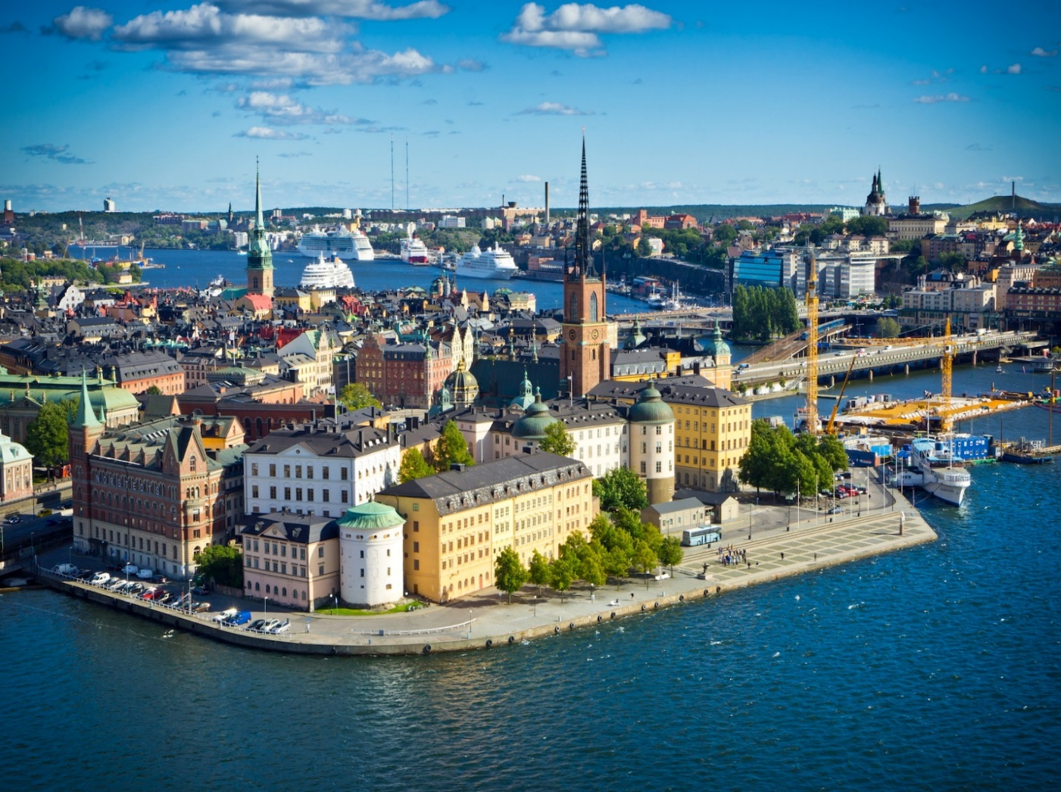
Equity partners
LOCALLY
Members are:
Owners
They own and operate their own firms
Experienced
Clients are always served by a senior, experienced consultant
Motivated
They are active managers, personally engaged

Slide 13
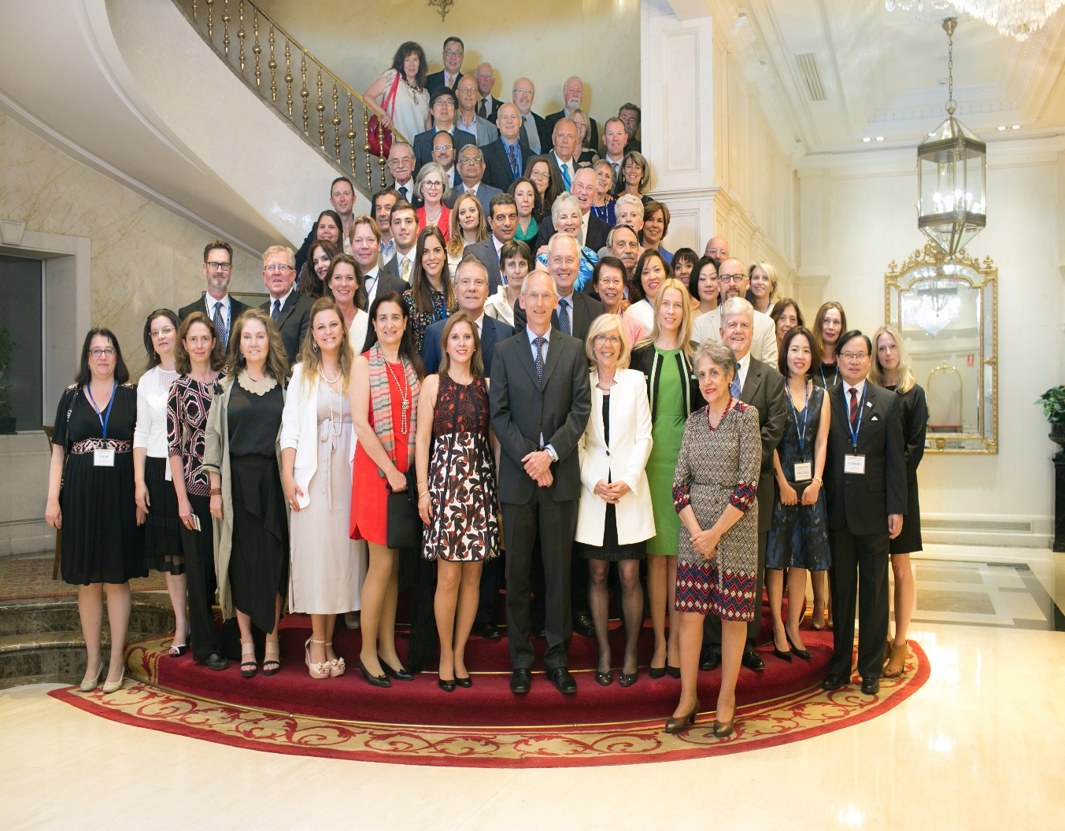
WORLD CLASS
They are also:
Recognized
Cornerstone is a global member of the AESC, the world-leading Association of Executive Search & Leadership Consultants
Qualified
All coaches belong to the #1 International Coach Federation
Ranked
Cornerstone is ranked in the top 25 by Forbes

Slide 14
Our
Services

Slide 15

WHAT
WE DO
We accelerate your success through top-quality consulting services for talent recruitment and development
We know how to attract the leaders you need for your business
We deliver better results faster with 29 years of experience
We don’t quit until you are satisfied

Slide 16
Services across the organization
Retained Executive Search
and key position recruitment
Executive Coaching
maximizing talent and accelerating ROI
Leadership Development
CEO Advisory Services
Assessments (multi-program portfolio)

Slide 17

Practice Groups

Slide 18








By Function
Operations
Sales & Marketing
Agile Talent
Human Resources
Finance & Legal
CEO & Board

Slide 19





By Industry
Industrial
Consumer
Infra structure
Life Sciences
Financial/ Fintech
Technology

Slide 20
Our
Global Board

Slide 21
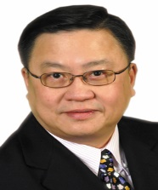
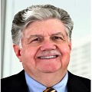
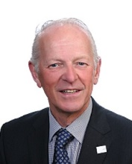
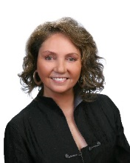
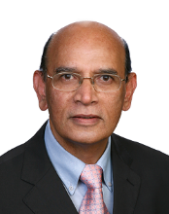
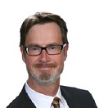
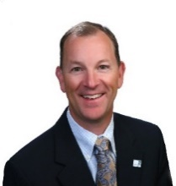
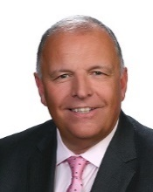
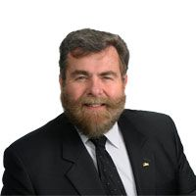
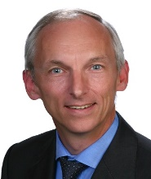
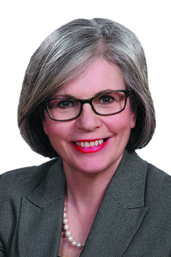
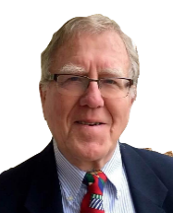
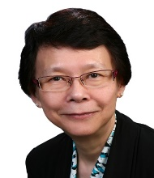
We are a small company of big thinkers
Simon Wan
Chairman & CEO (Shanghai)
Larry Shoemaker
President (Atlanta)
Ian Day
Executive Coaching
EMEA (London)
Alejandra Aranda
LATAM Region
(Santiago)
John Vijayarangam
Asia-Pacific Region
(Jakarta)
Goran Jansson
EMEA Region
(Stockholm)
Dan Heiman
North America Region
(Kansas City)
Alan Kneale
Member Development
EMEA (Liverpool)
Gary Agnew
Member Development
Americas (Vancouver)
Gerhard Benneck
M&A
(Dusseldorf)
Laurie O’Donnell
Executive Coaching
(Vancouver)
Chris Allan
Marketing
(Montreal)
Nancy Chu
Member Development
Asia (Hong Kong)

Slide 22
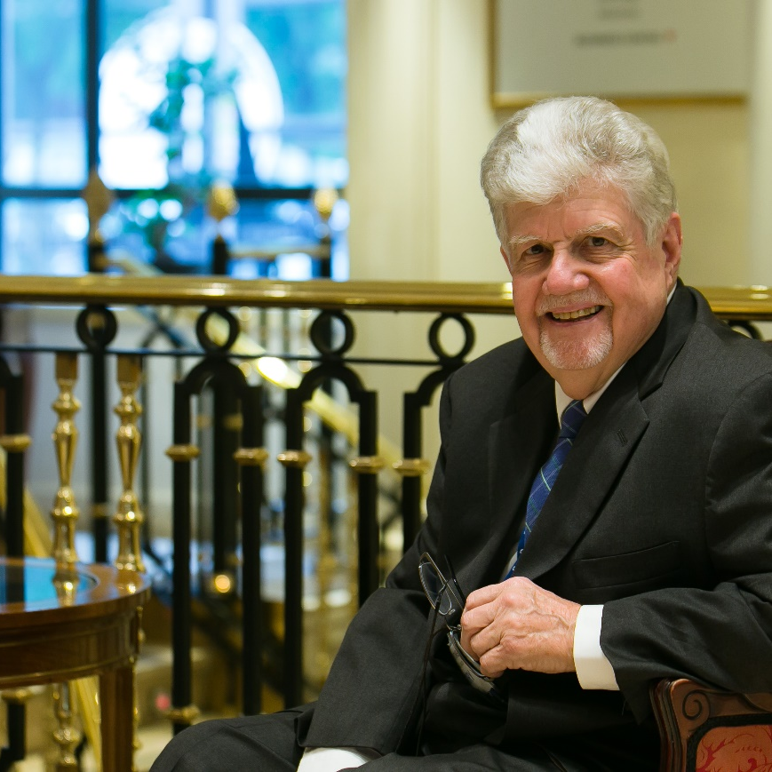
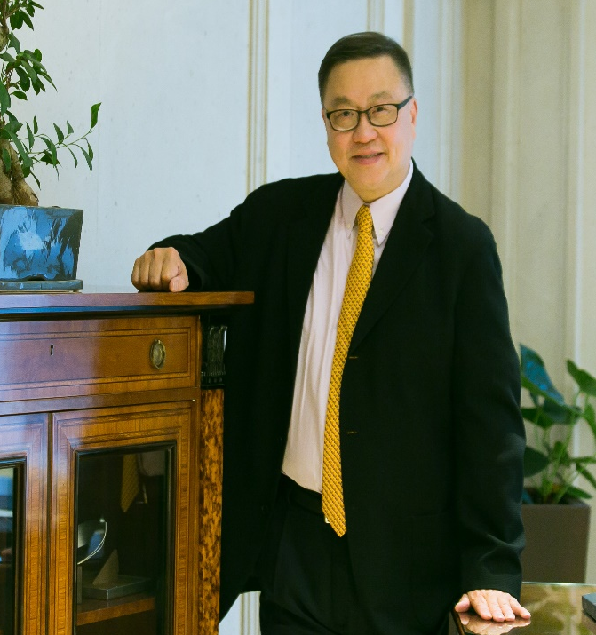
Now we’ve met, how can we help?
Visit www.cornerstone-group.com
Or contact
simon-wan@cornerstone-group.com
larry-shoemaker@cornerstone-group.com

