Slide 1


I
Achieve More With Cornerstone™
Global Services Introduction
Cornerstone International Group

Slide 2
Who We Are
Global Solution
in some 35 countries, 63 offices.
Committed Consultants
  equity partners locally with deep regional knowledge and expertise
Best Practices
lessons learned & shared across six continents
Stable Structure
since 1989, over 25 years of services

Slide 3
What We Deliver
Our core competency is Retained Executive Search.
To find the best candidate we benefit from deep, diverse contacts across a global network and state-of-the art assessment.
After finding the best candidate, we believe the most important factors leading to success are coaching and peer group support.

Slide 4
Our Global Services
Retained Executive Search and key position recruitment
CEO Advisory (including Cornerstone CEO committees - CCC)
Executive Coaching (maximizing talent and accelerating ROI)
Assessments (keeping square pegs out of round holes)

Slide 5
What We Bring
Quality and commitment
  Global Top-10 firm, local leadership
Expertise
  Senior, long-tenured consultants
Diversification
  Broad experience in industries, functions
Adaptability
  Clients from Fortune 1000 firms to local Champions
Simplicity
  Single window contact for multinational mandate

Slide 6
What Drives Us
Excellence
  We pursue excellence in everything we do
Professionalism
  Highly qualified consultants, proprietary technology
Trust
  Over 90% of our clientele are repeat or referred
Integrity
  Our reputation depends totally on your satisfaction
Respect
  Our equity partners locally are widely respected in their communities
  ‘Achieve More with Cornerstone’

Slide 7
1. Retained Executive Search
The Right Fit
4 out of 10 new executives fail within 18 months
Our key deliverable is compatibility
Proprietary assessments ensure the best talent
Thorough, “five-star” search process
Reinforcement with ‘Cornerstone Plus’ onboarding support program

Slide 8
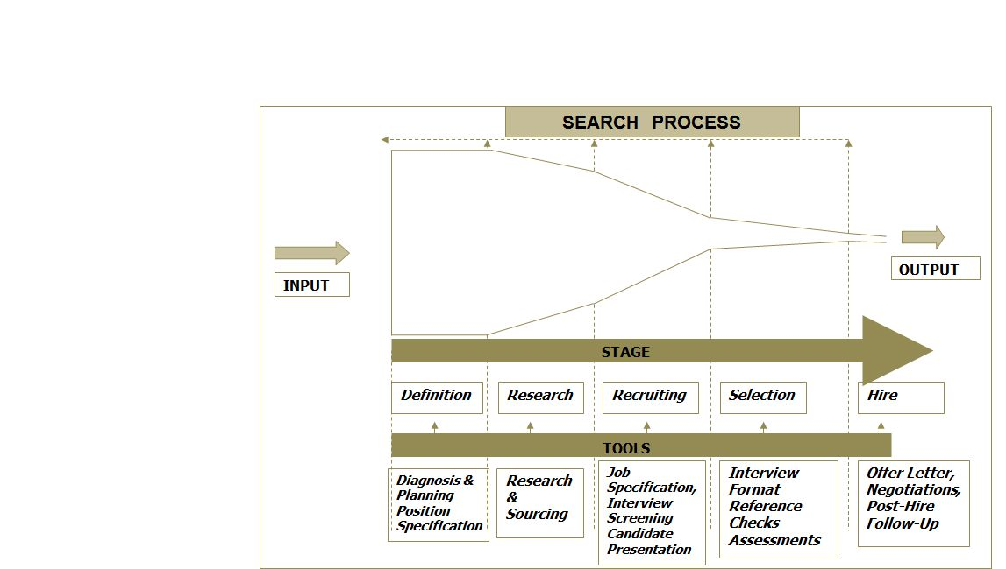
Five-Star Process
1. DEFINITION
Diagnosis and planning, position specification, complete agreement on the objective.

Slide 9
Five-Star Process
2. RESEARCH
Research and sourcing according to mandate. Many of our firms maintain databases of pre-screened candidates for key positions.

Slide 10
Five-Star Process
3. RECRUITING
We do the heavy lifting. We specify (to agreed norms) and screen likely candidates and present you with the best.

Slide 11
Five-Star Process
4. SELECTION
We will lead the interview to an agreed format if you wish. We verify references. Expert assessments and psychometric analyses lead to success.

Slide 12
Five-Star Process
5. HIRE
We handle the offer letter, negotiations and post-hire follow-up. We’re done only when you are satisfied.

Slide 13
Cornerstone Plus
Developing Star Performers
Unique add-on to secure new hire’s success
Combines elements from our coaching and on-boarding programs
Custom designed to match your needs
“Immersion” program design for fast results and rapid ROI

Slide 14

2) CEO ADVISORY
Helping CEOS and the Board to bring better judgement, objectivity and results

Slide 15
Board & CEO ADVISORY
Key Programs
Independent Director Search
Cornerstone CEO Committee (CCC),

Slide 16
Cornerstone CEO Committee (CCC)
Key Deliverables
CCC provides professionally facilitated, confidential peer advisory groups for CEOs, executives and business owners.
A trusted group of CEOs meets regularly to address real life business issues affecting performance of the business.
CEO can reflect, bounce ideas off his or her peers, or get wise counsel from peer CEOs & the experienced CEO advisor.
CCC sessions are held 12 times a year, eight sessions in group settings and four sessions one-on-one.

Slide 17

3. Executive Coaching Services
Structured coaching together with professional profiling / assessments of executive improves individual performance & builds better team success

Slide 18
Executive Coaching Services
Coaching Focus
One-on-one executive coaching
Assessments - Executive Profiling Tools
New leader transition / onboarding
Single window solutions for coaching your leadership team globally and professionally
ICF accredited ‘Cornerstone Executive Coach Certification (CECC)’ program, now available in India and China

Slide 19
Executive Coaching Services
Delivery of Coaching Services
ICF / CECC credentials & Cornerstone assessment tools - Highest Standard
Global pool of qualified coaches
In person or remote (Skype, GTM)
One-on-one or Team

Slide 20
Executive Coaching Services
Global Coaching Solution:
Delivered through our global network
ICF recognized coaches, experienced consultants
Single window for project reporting
Consistent program adapted globally

Slide 21
10-Step Coaching Process
Interview
Leader
Conduct Assessments
Step 1
Step 2
Step 3
Step 4
Step 5
Define Context and Set Parameters
Gather 360 Information
Review 360 and Assessments
Steps 1-5 = Building the Foundation

Slide 22
10-Step Coaching Process
Coach, Leader, Sponsor
Approve Development Plan
Mid-Program Review and Report
Step 6
Step 7
Step 8
Step 9
Step 10
Customize Coaching Development Plan
Coaching Sessions
Conclusion and/or Continuing Development
Steps 6-10 = Delivering the Results

Slide 23
4. Assessment Products
Revolutionary methodology
Psychometric tools to improve results through better people management.
Leading-edge products based on 13 years and 150,000 applications in 20 countries.
Profile of both candidate and the job to ensure compatibility

Slide 24
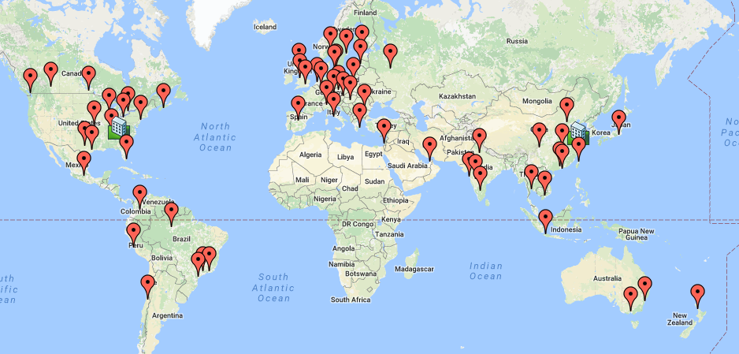
Our Global Network
26 years | 40 members | 63 Offices | 35 Countries
24

Slide 25




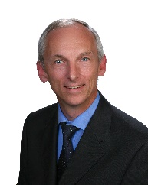
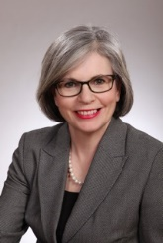
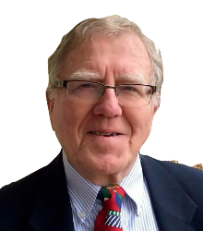
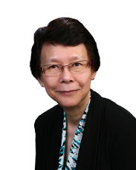

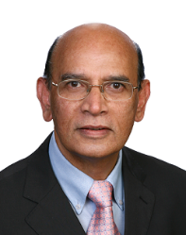



Chairman & CEO
Simon Wan (Shanghai)
simon-wan@cornerstone-group.com
President
Larry Shoemaker (Atlanta)
larry-shoemaker@cornerstone-group.com
Chair of Member Development
Ian Day (London)
Chair of Member Development
Alan Kneale (Liverpool)
Chair of M&A Services
Gerhard Benneck (Dusseldorgf)
Board Officer
Executive Coaching
Laurie O’Donnell (Beijing)
Board Officer
Marketing
Chris Allan (Montreal)
Board Officer
New Mermbers
Nancy Chu (Hong Kong)
Chair of USA Region
Audit Committee Chair
Dan Heiman (Kansas City)
Chair of Asia-Pacific
John Vijayarangam, Jakarta
Chair of EMEA Region
Goran Jansson (Stockholm)
Chair of Canada Region
Jill MacLeod (Toronto)
Chair, Latin America Region
Alejandra Aranda (Santiago)
Cornerstone International Group world headquarters are in Shanghai, China & Atlanta, USA.
25

Slide 26
Success is not easy
You cannot succeed without good people
Finding the best people is hard and improving your people is just as challenging
But this we know: the better you plan, the more intensely you commit, the greater your success
Let us be your partner in that success
‘Achieve More with Cornerstone’

Slide 27
Contact Us
We warmly welcome all requests for more information and to
Global Headquarters - East
Simon Wan
Chairman & Chief Executive
Cornerstone International Group
Shanghai, CHINA
Tel: 86 21-6474-7064
Email: simon-wan@cornerstone-group.com;
Global Headquarters - West
Larry Shoemaker
President, Cornerstone International Group
Atlanta, GA USA
Tel: 1-770-395-7225
Email: larry-shoemaker@cornerstone-group.com

Slide 28
I
Achieve More With Cornerstone™
Cornerstone International Group

