Slide 1

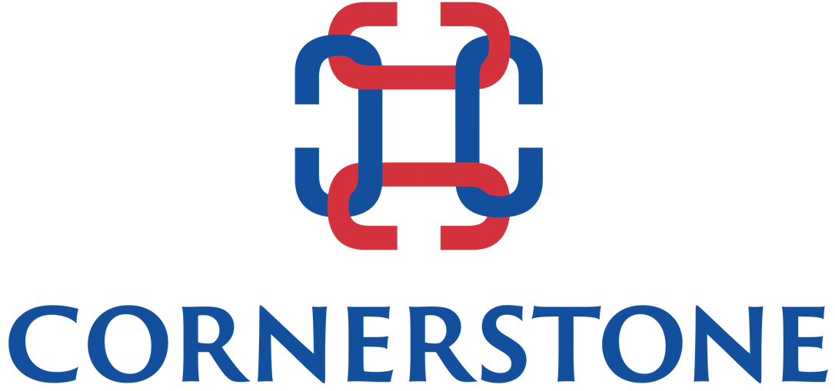


Career Navigator
60 Offices, 40 Countries since 1989
Next

Slide 2
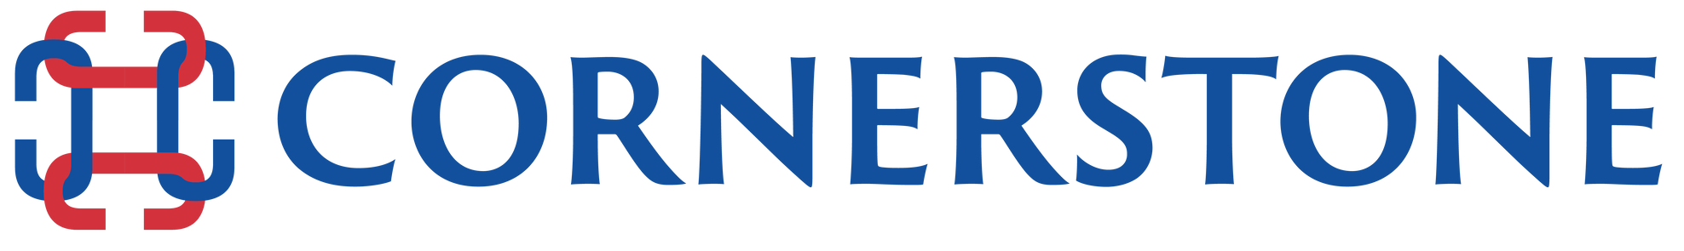





ABOUT US
Experience
Reach
Trust
Performance
1000+ Senior Level Searches in different continents across various industry verticals, family business and Global MNCs
An established network of 250+ Consultants in 60+ locations and 40 countries
Practice Leaders possess deep industry experiences in their home-ground and we serve as trusted advisors to our clients and candidates.
Ranked by Forbes, Hunt Scanlon and AESC (Association of Executive Search Consultants) as the best of the best firms of the industry
Next

Slide 3



CORE BUSINESS SOLUTION
EXECUTIVE SEARCH
CAREER NAVIGATORS
COACHING LEADERS
Next

Slide 4

ZERO RISK
CAREER TRANSITION & MANAGEMENT PROGRAM
Cornerstone has been providing career navigation services to candidates since 1989.
We help our clients build an organization of informed, able people who will lead their firms in their goal of becoming global leaders in their fields. We believe career navigation will optimize your investment in your staff as well as enhance your reputation of being an outstanding employer.
Next

Slide 5

TOP 5 CHALLENGE
Next

Slide 6
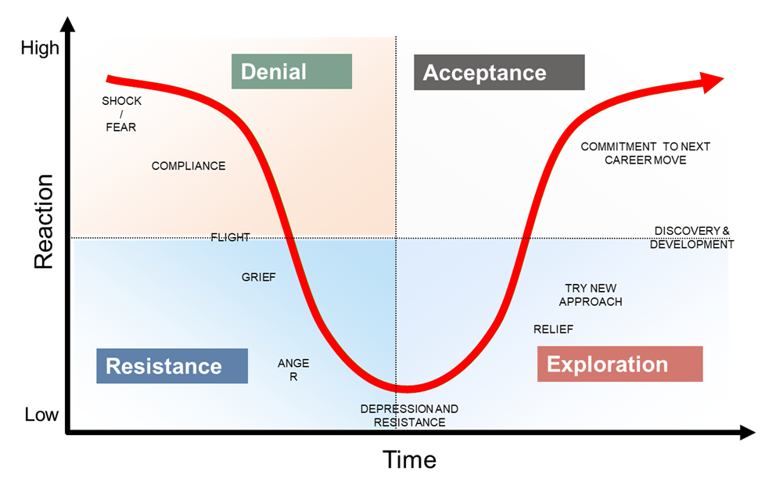
EMPLOYEE EMOTIONAL STAGE
Next

Slide 7

ONE-ON-ONE CUSTOMIZED CAREER CONSULTING
  Resume development
  LinkedIn profile & strategies
  Assessment tools
  Networking best practices
  Video interview training
  Social media training
  Webinar topics
  Access to CORNERSTONE's network
Next

Slide 8




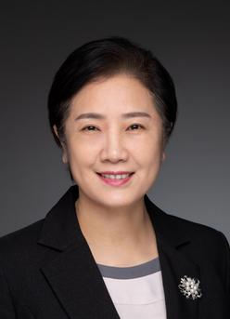
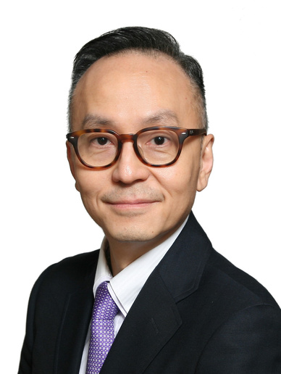








EXECUTIVE TEAM IN ASIA
Simon Wan
Frank Koh
Aloysius Tan
Kathy Liu
Teresa Wang
Raymond Lee
Frances Lee
Hongkong
Singapore
Shanghai
Beijing
Beijing
Hongkong
Taipei
Yumiko Tang
Vivian Shi
Kuang Fu
Elaine Fan
Anthony Lo
Nancy Chu
Irene Lin
Shanghai
Shanghai
Suzhou
Shanghai
Hongkong
Hongkong
Taipei

Slide 9


Thank You

