Slide 1
Cornerstone Global Conference
Lima, Peru, May 11-14, 2016
Conference Theme: T.E.A.M. CORNERSTONE
Together Each will Achieve More

Slide 2

TEAM ASIA
EXECUTIVE SEARCH - NOW & THE FUTURE (2020)
T.E.A.M. CORNERSTONE
Together Each will Achieve More

Slide 3
TODAY AND THE FUTURE
2016
2020
IF YOU DON’T KNOW WHERE YOU
ARE GOING , IT DOES NOT MATTER
WHICH ROAD YOU TAKE

Slide 4


TEAM ASIA
WHERE ARE WE NOW? (MAY 2016)
HOW DO WE GET THERE?
WHERE DO WE WANT TO BE? (2020)
T.E.A.M. CORNERSTONE
Together Each will Achieve More

Slide 5
FOUR PERSPECTIVES
Macro Aspects of Economic / Political Scenario
Executvie Search & The HR Function
Technological Changes
Analysis of Changing Trends
How will it impact Asia
How will it evolve in the next four years and the sub-function of Executive Search
Changes that would have a profound impact on jobs, the way we work, the way we recruit
Adaptation

Slide 6
TODAY AND THE FUTURE
ITS TIME FOR US TO LOOK BEYOND HIRES
AND PUTTING OUT FIRES
PROFESSIONAL SERVICE FIRMS ARE
CONTINOUSLY EVOLVING “

Slide 7
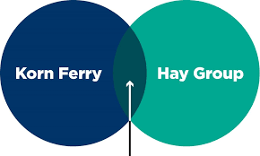
TRENDS
AND WHAT ARE EXECUTIVE SEARCH FIRMS DOING ?
WHY?

Slide 8
INTERESTNG TRENDS
THE MUSE.COM
GREENHOUSE
GLASSDOOR
JOBVITES

Slide 9
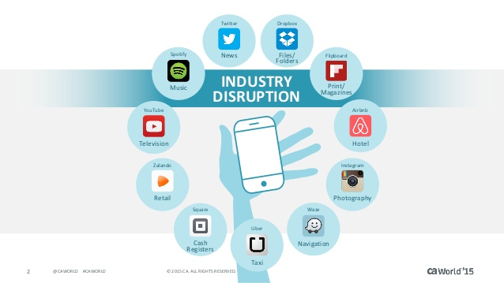

DISINTERMEDIATION
Disintermediation – eliminate the middle man
T.E.A.M. CORNERSTONE
Together Each will Achieve More

Slide 10
FUTURE TRENDS
TYPES OF CHANGES
New types of Organization emerging / old ones doing defunct
New types of Jobs – we should start researching / studying this
New Technology in HR & Executive Search
TRENDS TO OBSERVE
What are our competitors doing?
How are HR Directors reacting to these changes?

Slide 11

NEW BROOM WITH DISINTERMEDIATION
RECRUITING MANAGER – MORE ACTIVE
RESEARCH FIRMS PROVIDE INFORMATION DIRECTLY TO HR
MORE DISRUPTIONS
MERGER AND ACQUISITIONS

Slide 12

ADAPT & CHANGE
AT THE LOCAL LEVEL :
Build Synergy – with members
Give Referrals
Build on our strengths
AT OUR CORPORATE / HQ LEVEL :
Develop quantifiable measures to evaluated ‘ value added ‘ services
Hope members assess “ ROI “
Has my sales revenue increased thanks to CIG ?

Slide 13

T.E.A.M. CORNERSTONE
Together Each will Achieve More

