Slide 1










CORNERSTONE
EXECUTIVE COACHING
WE HELP TO DEVELOP GREAT LEADERS WHO GO ON TO BUILD GREAT COMPANIES

Slide 2

LET’S START HERE….
Ranked by Forbes among the Top 20 retained search firms in America, Cornerstone International Group is one of the largest independent search networks in the world. With headquarters in Shanghai, China and Atlanta, USA, it has 60 offices in 40 countries and 33 years of history. Cornerstone specializes in recruiting CEO and executive level talent for companies with cross-border operations and successfully closes over 1,000 searches annually. Our leadership development practice includes over 100 ICF-certified professional coaches.
ACHIEVE MORE WITH CORNERSTONE.

Slide 3



1.
WE’RE GLOBAL
We are partner to clients ranging from large multi-nationals to small local companies

Slide 4
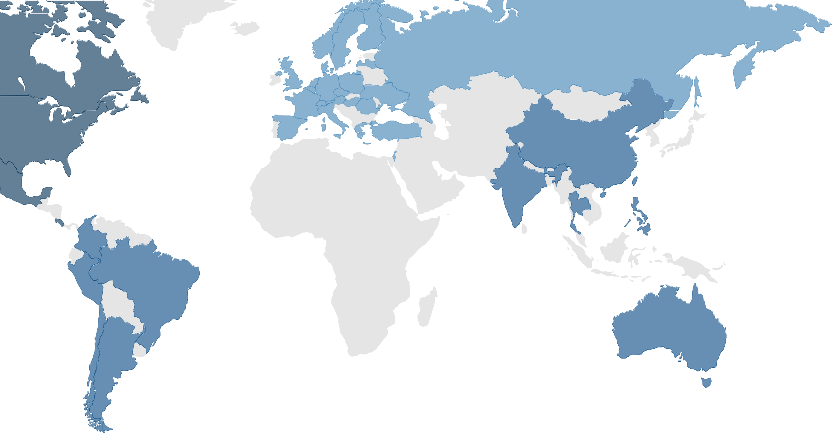
CAPABILITY
Europe
27 offices
105 professionals
363 searches 2019
15 Executive Coaches
190 coach projects 2019
Americas
14 offices
81 professionals
780 searches 2019
57 Executive Coaches
722 coach projects 2019
Asia-Pacific
13 offices
64 professionals
171 searches in 2019
28 Executive Coaches
338 coach projects in 2019
Austria
Belgium
Czech Republic
Netherlands
Denmark
England
Finland
France
Germany
Greece
Hungary
Israel
Italy
Netherlands
Norway
Poland
Romania
Russia
Saudi Arabia Spain
Sweden
Switzerland
Turkey
UAE
Ukraine
China
Australia
India
Japan
Philippines
Singapore
Taiwan
Thailand
Argentina Brazil
Chile
Colombia
Peru
USA
Canada
Costa Rica
Mexico

Slide 5



RETAINED EXECUTIVE SEARCH
and key position recruitment
EXECUTIVE COACHING
maximizing talent and accelerating ROI
SERVICES
ACROSS THE ORGANIZATION
LEADER DEVELOPMENT
Leadership Academy 4.0
CAREER MANAGEMENT
multi-program portfolio

Slide 6



2.
EXECUTIVE COACHING
Professional coaching has impact across the organization

Slide 7


EXECUTIVE COACHING
“We help Business Leaders at all levels leverage their leadership skills to maximize success.
“Executive Coaches partner with successful Business Leaders, High Potentials and Executives who wish to improve their effectiveness; enhance their management style; improve results; develop their ability to influence; enhance leadership skills and performance; and achieve personal and organizational goals.”

Slide 8

COACHING IS CHANGING
FROM TACTICAL
Coaching as remediation.
Only senior executives
TO STRATEGIC
Key leadership development investment in performance
Mid level managers develop future leader

Slide 9

IMPACT OF COACHING ACROSS THE ORGANIZATION
Coaching overtaking consulting Coaching is recognized and accepted Laser focus on Interpersonal Skills
Ability to demonstrate measurable results
EXECUTIVE
Coaching for future Leaders Succession planning
Managers consolidating coaching skills
MID–SENIOR MANAGEMENT
Introducing coaching skills Learning to develop others Team Coaching
Group Coaching
Use of Apps/Technology
FRONT LINE LEADERS/INDIVIDUAL CONTRIBUTORS

Slide 10


3.
HOW YOU BENEFIT
Searching for the right coach is critical. We have simplified the process by giving you a single point of access to over 100 certified coaches in 20 countries...

Slide 11

A COMPREHENSIVE SERVICE
GLOBAL PRESENCE
100+ certified coaches on four continents are located in 20 countries
QUALITY
We only hire professionally trained coaches recognized worldwide by the International Coaching Federation
SIMPLICITY
One point of contact for any global coaching requirement.
CONSISTENCY
You get top quality, ICF-approved coaching even in unfamiliar markets
EXPERIENCE
Our coaches complete over 1,250 assignments each year
YOUR COACH, YOUR LANGUAGE
Our coaches speak 14 languages

Slide 12

Assessing strengths & potential areas of improvement
Reconfirming personal goals
Setting up development and coaching goals
OUR APPROACH
Customizing the program
Analyzing outcomes
Adjusting as we progress

Slide 13




OUR PROCESS
- Establish baseline metrics via interviews, assessments and survey
- Deliver professional coaching and share resources for development
- Launch sustainability plan to ensure learning outcomes are embraced
DISCOVERY
CUSTOMIZE
FOLLOW-UP
ASSESSMENTS
DELIVERY
SUSTAINABILITY
- Define needs and expectations
- Examine desired outcomes, benefits, timing, strategies and investment
- Design leadership strategy based on development opportunities, needs and outcomes
- Check-in with each participant and stakeholder tean champion for feedback

Slide 14

ONE POINT OF CONTACT
Contact CORNERSTONE INTERNATIONAL GROUP COACHING
Feel free to contact us directly.
One point of contact for Coaching Globally.
Laurie-odonnell@cornerstone-group.com North America: 778 928 5948
China: 86 186 1196 6151

Slide 15

Simon Wan, Chairman & CEO (SHANGHAI)
simon-wan@cornerstone-group.com
Larry Shoemaker, President (ATLANTA)
larry-shoemaker@cornerstone-group.com
Laurie O’Donnell, Executive Coaching
laurie-odonnell@cornerstone-group.com
Nance Macleod, Career Management & Brain Trust
nance-macleod@cornerstone-group.com
Goran Jansson, EMEA
goran-jansson@cornerstone-group.com
Dan Heiman, North America
dan-heiman@cornerstone-group.com
Edwin Yeo, Asia-Pacific
edwin-yeo@cornerstone-group.com
Diego Cubas, Latin America
diego-cubas@cornerstone-group.com
OUR GLOBAL BOARD

